Slide 1
SEATS Partner Training: New Car Seat Request and Distribution Process

Slide 2
New Car Seat Portal Objectives
Provide real-time response to car seat requests so providers know that the member is eligible for a car seat
Provide some flexibility with reporting car seat distributions to UCare
Report anytime during the month, but by the end of the distribution month.
Use existing sign-on to the UCare Provider Portal

Slide 3
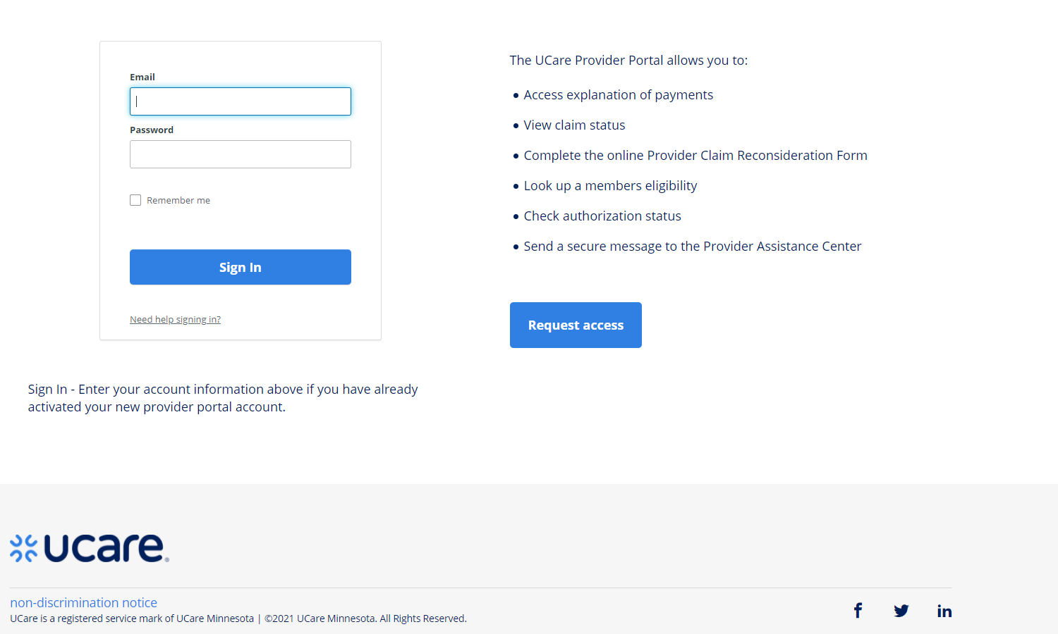
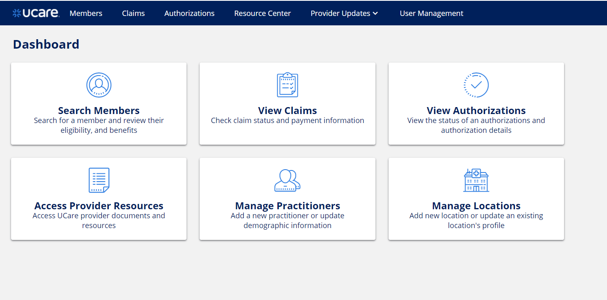
Signing On
If you do not have a user account, please contact SEATS@ucare.org for assistance.
Use your email and password to log in to the Provider Portal log in page through.
ucare.org/providers/
After logging in, click on the Resource Center tab
(your dashboard may look slightly different than this example)

Slide 4
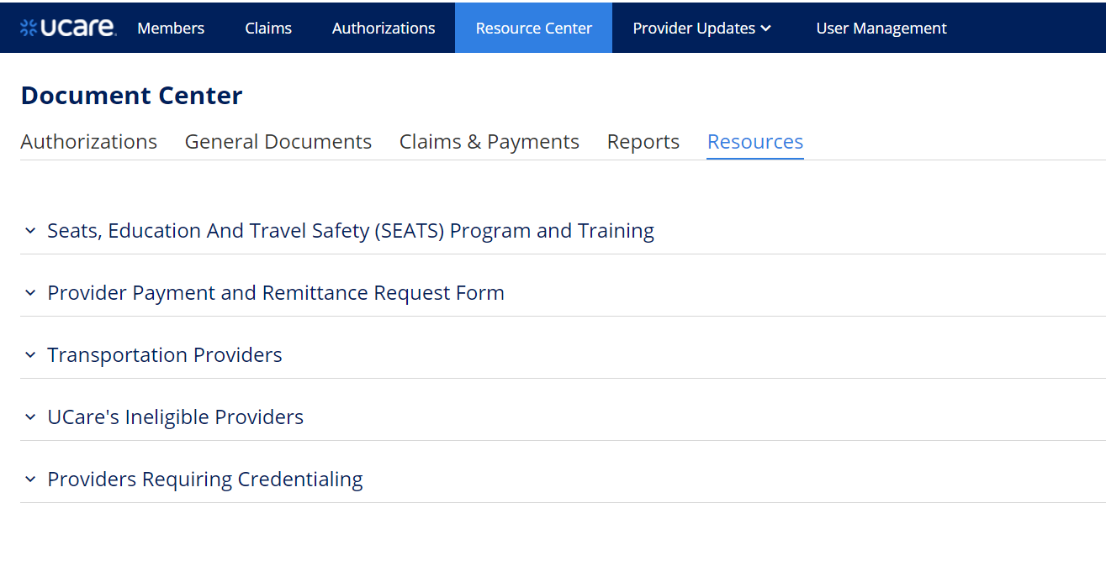
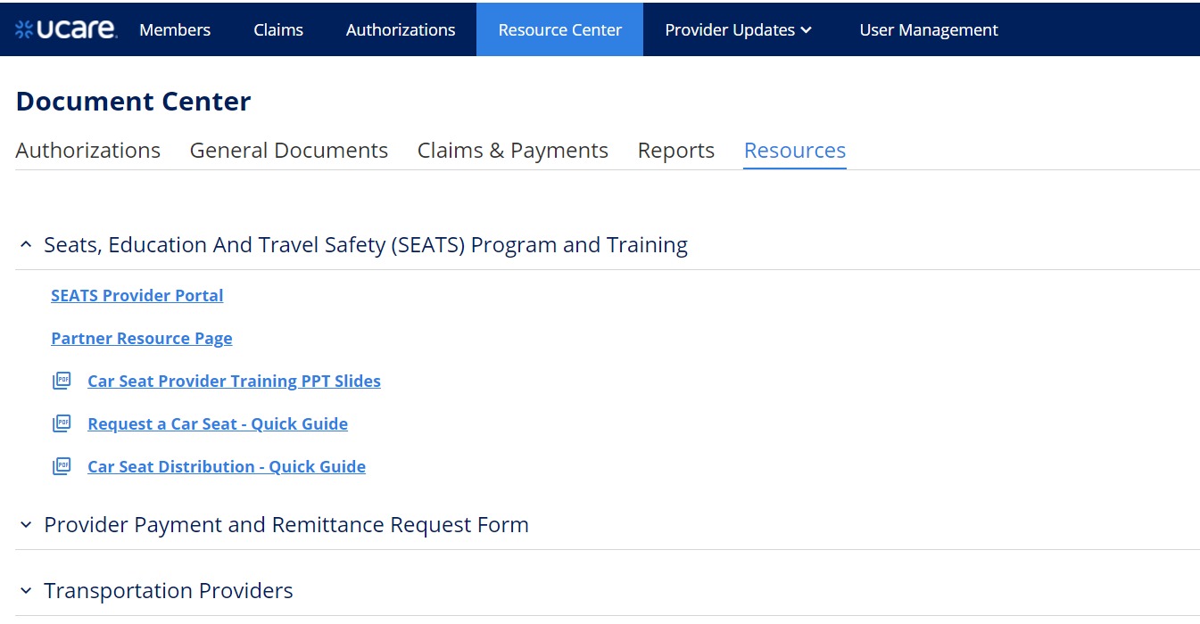
Signing on (continued)
Under the Resource Center tab, click Seats, Education and Travel Safety Program and Training.
Select the SEATS Provider Portal hyperlink. You will then be transferred to the car seat portal.

Slide 5
Initial ChipRewards Screen
Member Button
Once the link for the SEATS provider portal is clicked, the main dashboard will display.
Your UCare provider portal username will display in the upper right-hand corner.
The menu option MEMBERS will present.
Click on this Member button, the Member Search screen will display.
Notes:
After Feb 3rd, your Provider Portal username will replace “Car_seat_provider” in example above.

Slide 6
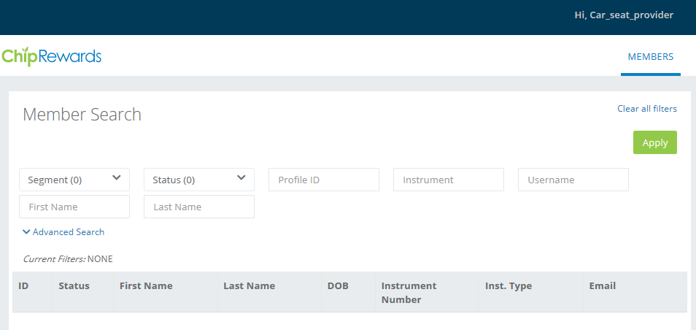
Member Search
Input the fields to search for the member and click Apply (or Enter)
Instrument = UCare Member ID
First Name = Member’s first name
Last Name = Member’s last name
(1) Member Search Fields
(2) Advanced Search
If you need to use the advanced search, click on this button and the search fields expand to provide additional fields to help find the member. Fields such as:
DOB = Date of Birth
Enter the DOB when searching for a member by name.
Notes:
Advanced Search: Use only if you cannot find the member using their UCare member ID. Search with First Name, Last Name and DOB

Slide 7
Member Selection
The Member Search will provide the members that match the search criteria.
To select the member, click on the corresponding ID on the far left column.

Slide 8
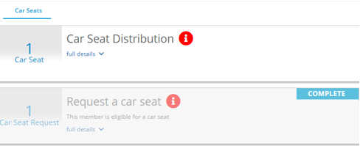
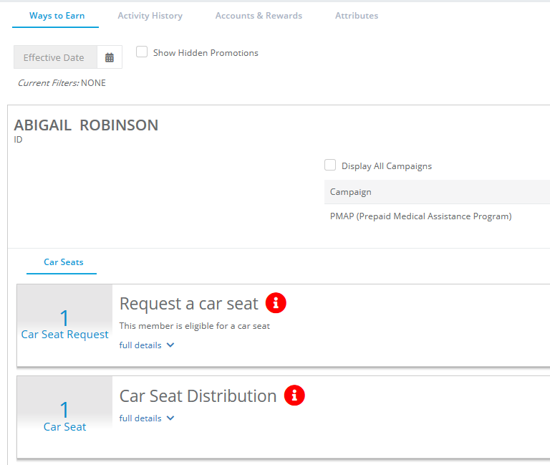
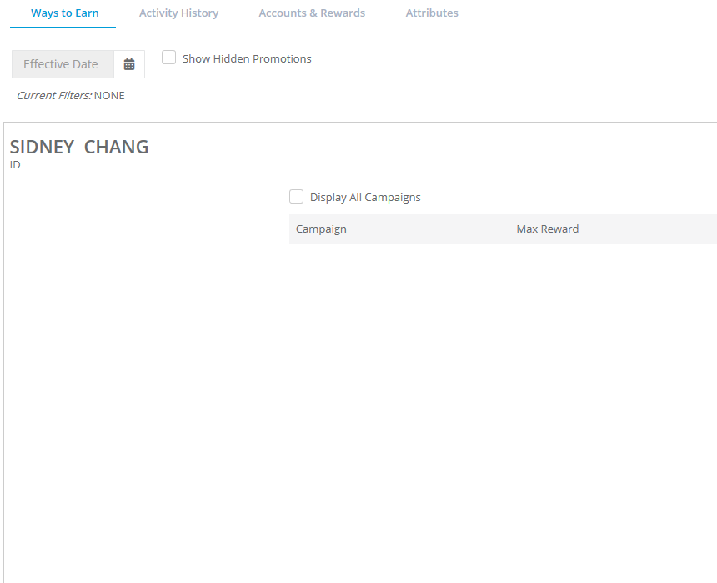
Member Inquiry Screen – Ways to Earn Alternate Views
These are four possible displays of the Ways to Earn screen based on the member’s scenario:
1
2
Request a Car Seat
If “Request a car seat” is not shaded. This means that the member is eligible in the current month for a car seat and you may input a request.
(2) Car Seat Distribution
If “Request a car seat” is shaded “ and “Car Seat Distribution” is not shaded, this means that a provider has requested a car seat in the current month for the member and the distribution is pending.
(3) Member is not currently eligible
The member is no longer eligible, but has had a car seat distribution in the past. To view when a member is next eligible, view the “Attributes” tab
(4) Member is termed/does not meet eligibility
The member does not meet the program criteria or is no longer on a UCare plan but was a member in the past.
4
3
Notes:
After you click on ID on the previous slide, it’ll take you to the next screen. There are FOUR possible displays, as shown above.

Slide 9
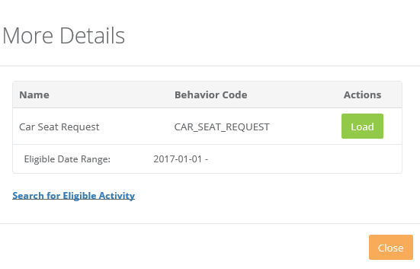
Ways to Earn – Request a Car Seat
This is the member’s Ways to Earn screen, showing that the member is eligible for a car seat.
The screen, as shown on the left, displays both the Request and Distribution actions (not shaded) if the member is eligible for a car seat.
1. To request a car seat, click on the button.
2. The More Details screen will display showing this is a car seat request. Click on the Load button.
See next slide for next steps….

Slide 10
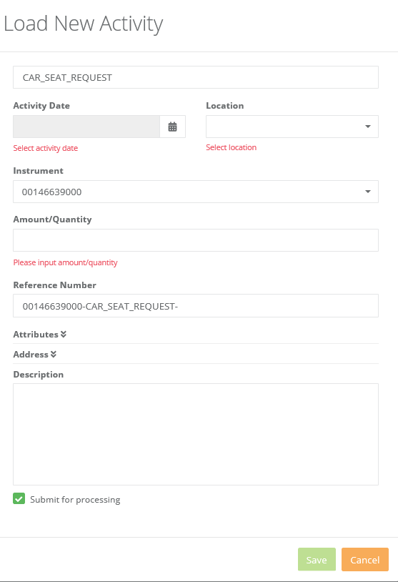
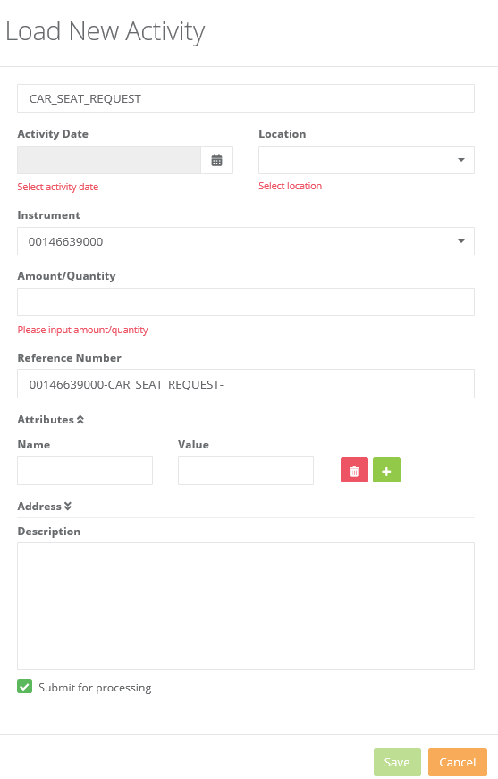
Request a Car Seat – Load Activity Screen
Input view for a Child Member
Load New Activity
Input Instructions (for either member):
Activity Date: Input today’s date, assuming that the car seat distribution will occur in the same month.
Location: This will default to the provider’s location
Instrument: Will default to the member’s ID
Reference Number: Auto defaulted by system, no input needed.
Quantity: Input the number of car seats being requested.
Attributes: Note: This section only needed for pregnant members. Click the down arrow to “open” this field. Enter the member’s due date following this format:
Name=due
Value=MM/DD/YYYY
Description: Input any optional text, which will show on the activity history transaction.
Then click Save. The car seat request will save and display the Activity History showing the transaction.
Input for a Pregnant Member
due
6/15/2020
Notes:
For a pregnant member, if the due date is not input into the Attributes section, then the request will not approve (will reward “0”). Your input in the Attribute’s Name field, must be in all lowercase letters (“due”).

Slide 11
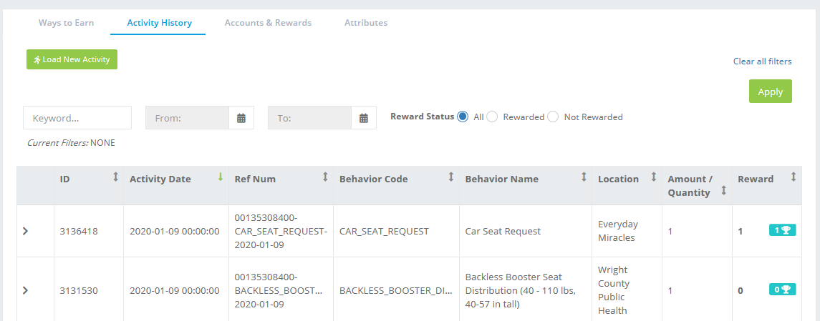
Car Seat Request – Activity History
After the Car Seat Request load activity was saved, it will default to the Activity Screen as shown below.
The Car Seat request will show as the last activity for this member.
Be sure that the reward indicates 1 for this Car Seat Request, which means that it was processed and the request was APPROVED for car seat distribution.
System Note: You may need to refresh the screen to see Reward = 1
OR
Click back to the Ways to Earn screen to show the request was marked complete.
See next slide to diagnose any issues.
Notes:
The Reward column must indicate a 1 for your car seat request to be approved. Remember to fresh your page if you are seeing a zero (0).

Slide 12
Reward Scoring - Denial
Should your car seat request score a zero (0) and not 1. Here are ways to diagnose what could be wrong.
Step 1. From the Activity History screen click the “>” button on the left column to expand the detail of the Car Seat Request.
Step 2. Look at the processing details to see what the error message says.
In this case, it was a pregnant member and the activity load of a Car Seat Request did not have the due date added to the attribute field.
Because this was an error the car seat request was processed but not scored or approved.

Slide 13
Car Seat Request
Error Messages
Error Message | How to solve
Activity must contain the attribute due (due date is missing) | Car Seat Request needs to be loaded (again) and this time the attribute field of due date needs to be input. In the reference number field add a “2” to the end of the string, indicating this is the second activity with the same detail. On Load Activity screen, reinput car seat request but be sure to click the “>” arrow on attributes which will open the field and key in member due date: Name=due Value= MM/DD/YYYY Then save, this time it should score = 1
Activity cannot be before 1 day(s) ago (did not input today’s date) | 1. You cannot input a date prior to today’s date. Resubmit your request with today’s date.
2

Slide 14
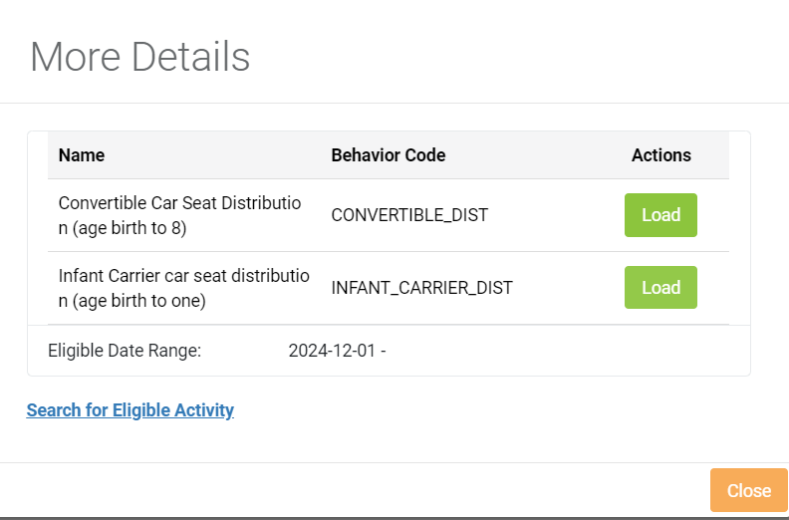
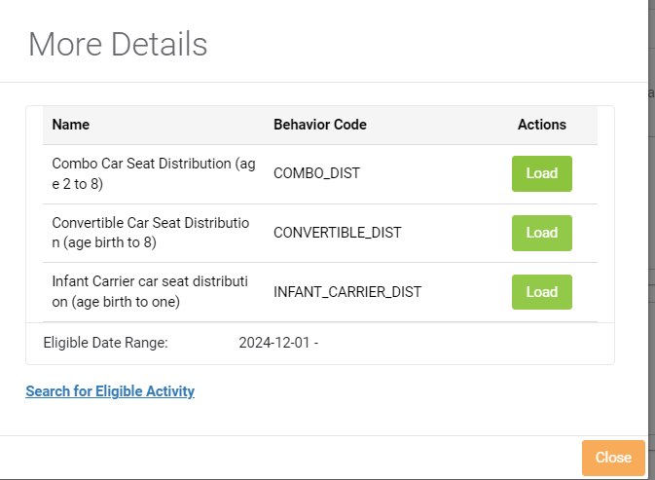
Ways to Earn – Car Seat Distribution
Below is the member’s Ways to Earn screen, with the option, Car Seat Distribution.
Please note that a Car Seat Distribution will only process and score (1) after a Car Seat Request has been made and input is during the distribution month.
The request is needed to confirm the member’s eligibility.
The screen, as shown on the left, displays the Distribution action.
1. To input a Car Seat Distribution click on the button.
2. The More Details screen will display showing the car seat distribution screen. Click the Load button to advance to the Load Activity Screen. See next slide.
There are two different More Details screens:
A: Pregnant Member, which will default to convertible seat or infant carrier
B: Child Member, which will present the seat options to choose from.
A. Pregnant Member B. Child Member
Notes:
“Big Kid Booster” = High weight harness car seat (COSCO Finale)

Slide 15
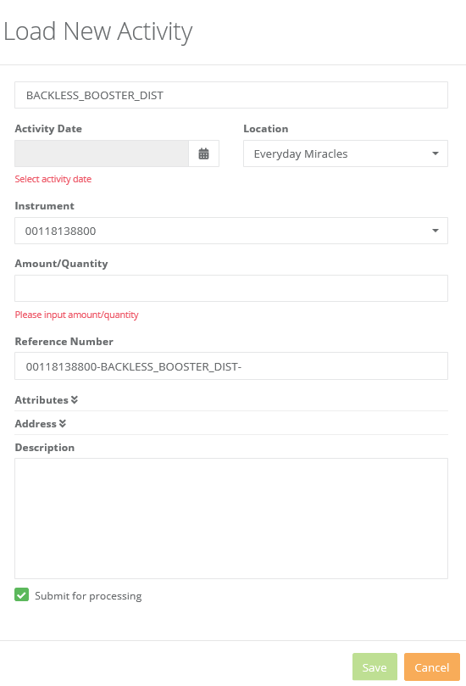
Car Seat Distribution– Load Activity Screen
Car Seat Distribution Load New Activity
Input Instructions:
Activity Date: Input the date that the car seat was distributed. The distribution date must have occurred after the request date and during the month of the car seat request to score/reward (1).
Location: This will default to the provider’s location
Instrument: Will default to the member’s UCare ID
Reference Number: Auto defaulted by system, no input needed.
Quantity: Input the number of car seats being distributed.
Attributes: No input is necessary on a distribution
Description: Input any text, which will show on the activity history transaction.
Then click Save and the distribution activity will process and display on the Activity History screen showing the transaction.
Notes:
Walk through display screen.

Slide 16
Member Inquiry Screen – Activity History
After the Car Seat Distribution activity is saved, it will default to the Activity Screen as shown below.
The Car Seat distribution request will show as the last activity for this member.
Be sure that the reward indicates 1 for this Car Seat Distribution, which means that it was processed and the submission was accepted.
System Notes:
If you are seeing a zero (0) and not 1, then you may need to refresh your screen, or click back to the Ways to Earn screen and then back to Activity History to ensure it has scored 1 (just like the Request a Car Seat).
You can click the “>” button next to the activity to see the processing notes, and see if there are any error messages.
Notes:
Remember to fresh your page if you are seeing a zero (0) or press the arrow (>) on the far left column to troubleshoot.
If you distributed more than 1 seat because a pregnant member is expecting multiples, then the Reward column will show the number of seats that you distributed. For example, if expecting triplets, the Reward will show as 3, for 3 car seats.

Slide 17
Car Seat Distribution Completion
Now that you have requested and distributed a car seat for this member. The member is no longer eligible for a car seat.
The Ways to Earn screen will display as shown below:
If you need to see when a member will be eligible for a car seat in the future, click on the Member’s Attributes tab. The Effective To date shows the next date in which they are eligible again.

Slide 18
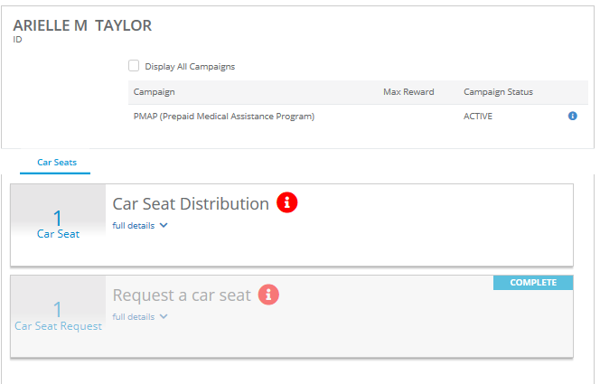
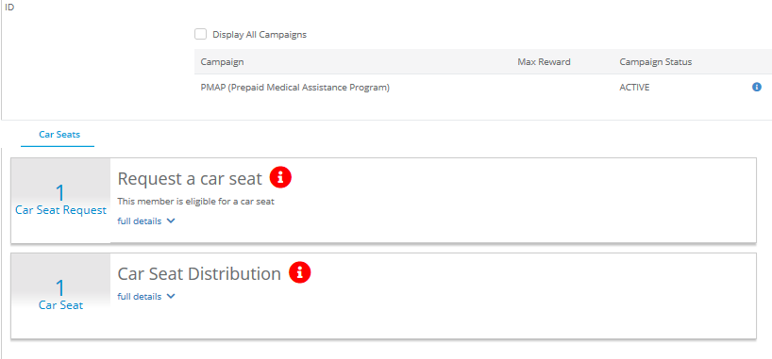
Car Seat Request Expiration/Reset
At the end of the month, if an approved car seat request had no distribution input, then the request will expire and reset for the next month.
If you did not distribute a car seat that you requested, you must re-submit a request next month to ensure that the member is still eligible.
Approved request month
(“Request a Car Seat” is shaded)
Next month, if no car seat distribution
(“Request a Car Seat” is not shaded)

Slide 19
Important Notes

Slide 20
System Reminders
Be sure to verify that car seat requests and distributions process and Reward (1) on the Activity History screen.
Requests made in the system that do not have a reported distribution in the same month will EXPIRE in the next month. A new request will need to be input for each month.
If you need to see when a member is eligible for a car seat again, you can view this under the member’s Attributes tab. The Effective To date this is when the member will be eligible next for a car seat.
If a request was made for a pregnant member and the Attribute of due date was omitted from the input, the request will not reward (1) so input will be needed again.
Key due date as: Name=due
Value=DD/MM/YYYY (their due date)
Add a digit (i.e. 2) to the Reference Number; otherwise you will get another error message with the second input. (Will fix in a future release)

Slide 21
Important Updates/Reminders
Car seat(s) request/distribution eligibility will continue to be based on prior car seat issuance.
NEW: Car seats for a pregnant member should be issued only in the 3rd trimester.
NEW: Report car seat inventory counts on new car seat order form (eff. 2/3)
Found on SEATS Partner Resources page.
Please be timely in the input of requests and distributions
By the end of the distribution month
There will be a system error if distributions are input after the distribution month.
No changes to Car Seat Exception Request process
If eligibility was not checked and distribution occurred for a non-eligible member, provider will be responsible for reimbursement of seat and no billing can occur for service.
Notes:
Timely input helps reduce the risk of members going to multiple partners for seats.

Slide 22
Resources
SEATS Partner Resources Page
https://home.ucare.org/en-us/providers/seats/
Training PPT will be posted showing more details about new system
Recorded webinar will be available for replay purposes
Updated Car Seat Order form
Email for support at SEATS@ucare.org

Slide 23
Questions?
Send questions via chat box

Slide 24
Quick Reference

Slide 25
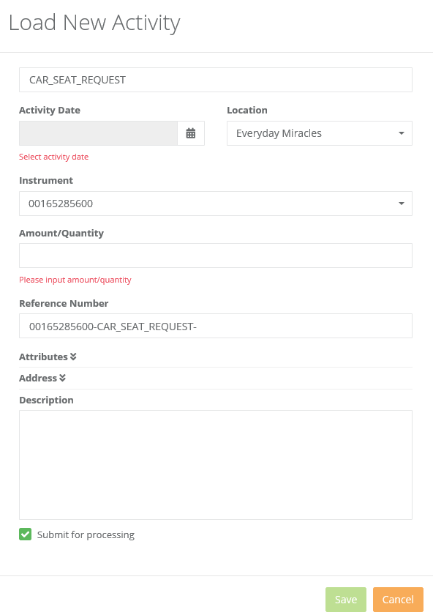
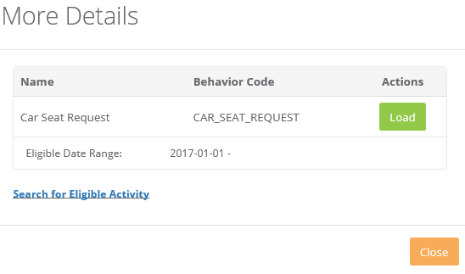
Request a Car Seat Input
3
1
Load New Activity
Input Instructions:
Activity Date: Input today’s date, assuming that the car seat distribution will occur in the current month.
Location: This will default to the provider’s location
Instrument: Will default to the member’s ID
Reference Number: Auto defaulted by system, no input needed.
Quantity: Input the number of car seats being requested.
Attributes: Click the down arrow to open this field. For any pregnant members that are requesting a car seat, enter their due date. Enter with the following format:
Name=due
Value=MM/DD/YYYY
Description: Input any text, which will show on the activity history transaction.
Then click Save and the request will save and display the Activity History showing the transaction.
Click on Members tab
Perform Member Search. Enter UCare ID in Instrument field.
Select member (click on ID hyperlink)
Click on Ways to Earn tab and then Request a Car Seat
Click the red and the More Details screen is displayed
2
Shown above is the More Details Screen
Click the Load button
The Load New Activity screen will display

Slide 26
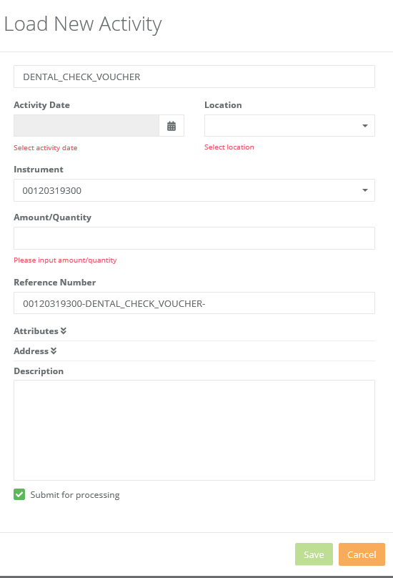
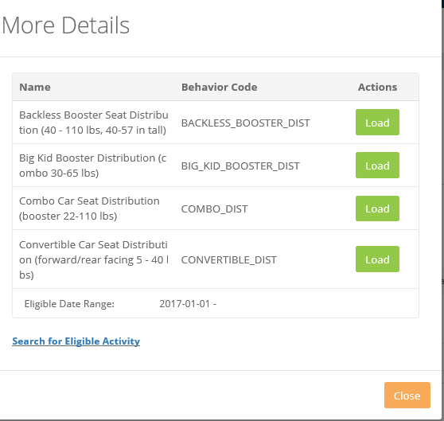
Distribute a Car Seat Input
1
Perform Member Search and Select Member
Click on Ways to Earn Tab and then Distribute a Car Seat
Click the red and the More Details screen is displayed
In this case the Car Seat Distribution
3
Load New Activity Input Instructions:
Activity Date: Input the date that the car seat was distributed. The distribution date must have occurred after the request date and during the month of the car seat request to score/reward.
Location: This will default to the provider’s location
Instrument: Will default to the member’s ID
Reference Number: Auto defaulted by system, no input needed.
Quantity: Input the number of car seats being distributed.
Attributes: No input is necessary on a distribution
Description: Input any text, which will show on the activity history transaction.
Then click Save and the request will save and display the Activity History showing the transaction.
2
Shown to the left is the More Details Screen
Click the Load button
The Load New Activity screen will display

Slide 27
Member Inquiry Screen – Accounts & Rewards
The Member’s Accounts & Rewards screen shows a slightly different display from Account Activity.
If there were any prior rewarded items, these would show on this screen. See screen shot and descriptions for more information.
Column Header | Description
ID | This is a system generated ID that is associated with each member’s transaction.
Amount | This is the number of units requested for either a request or distribution.
Account | Will indicate either Car Seat Request or Car Seat Distribution
Activity Type | Will always be reward
Original Activity Date | This is the date that was keyed in by the Car Seat provider when they loaded the activity for either requesting a car seat or distributing a car seat. This will be the date or expected date of the car seat distribution.
Date | This was the date in which the transaction was keyed to the system.
More Detail | This is a field that allows you to expand the transaction and see the various dates associated with this transaction
Notes:
Your notes here:

Slide 28
Member Inquiry Screen – Activity History
The Member’s Activity History shows transactions related to the Car Seat program. If there were any prior requests or distributions, these would show on this screen. See screen shot and descriptions for more information.
Column Header | Description
‘> Indicator | This indicator alongside each transaction allows the user to see more details about this transaction. By clicking this button, it opens the transaction to display further attributes, rewards and processing log information.
ID | This is a system generated ID that is associated with each member’s transaction.
Activity Date | This is the date that was keyed in by the Car Seat provider when they loaded the activity for either requesting a car seat or distributing a car seat. Typically, this will be the date or expected date of the car seat distribution.
Ref Number: | This is a system generated number comprised of the Member Number, Behavior and date in which this transaction was entered into ChipRewards.
Behavior Code | This will show as either the Car Seat Request or Distribution
Behavior Name | This will show as either the Car Seat Request or the type of car seat that was distributed/attempted to be distributed.
Location | The clinic location of the provider.
Quantity | Number of Car Seats being requested/distributed.
Reward | This is an indication of whether the system accepted the request/distribution with the following values: 0=It was not rewarded as it did not meet the business rules to be eligible 1= It was rewarded and met the business rules to be eligible for a request or distribution
Notes:
Your notes here:

Slide 29
Scenarios

Slide 30
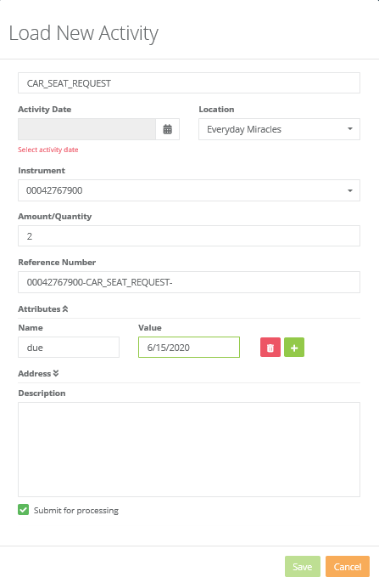
Exception Scenario:
Requesting car seats for a member that is an expectant mom with multiples
The system will allow for a car seat request where the quantity is more than one.
Go to the Ways to Earn screen and click on the “I” to request a car seat
More Details screen presents, click Load
Complete the Load New Activity input
Input quantity as either 2 or 3
Input the due date under attributes
Click Save, the request(s) will save and show as complete on Ways to Earn.

Slide 31
Exception Scenario:
Provider 1 requested car seat for a member
Provider 2 is looking to request a car seat for the same member
The system will only allow one car seat request to be pending for a member
If the Ways to Earn screen shows the car seat request is greyed out, this means another provider has already requested and expects to distribute the same month. Steps to follow to confirm this scenario:
Step 1: Look at Ways to Earn Step 2: Look at Activity History
If greyed out, already requested To determine provider that requested.
You can advise member to see that provider location.
*If a member informs you that they no longer want a car seat from Provider 1, email SEATS@ucare.org to review the approval.

Slide 32
Exception Scenario:
End of month reset of a Car Seat Request
The system will auto-expire any pending car seat requests that have not had a distribution keyed in the same month.
*This is to prevent a car seat from being distributed to a member that may not be eligible.
*After the release of the request, the system will show member as eligible for a car seat request.
Distribution happened in the prior month and the car seat request was already keyed into the system.
The current view of the member’s Ways to Earn screen will show both the request and distribution available (not shaded), as the request has expired.
Contact SEATS@ucare.org to resolve the issue.
Distribution happened in the month after the car seat request was keyed into the system.
The current view of the member’s Ways to Earn screen will show both the request and distribution available (not shaded)
You will not be able to enter a distribution if a request was not input and approved in the current month.
Contact SEATS@ucare.org to resolve the issue.

