Slide 1
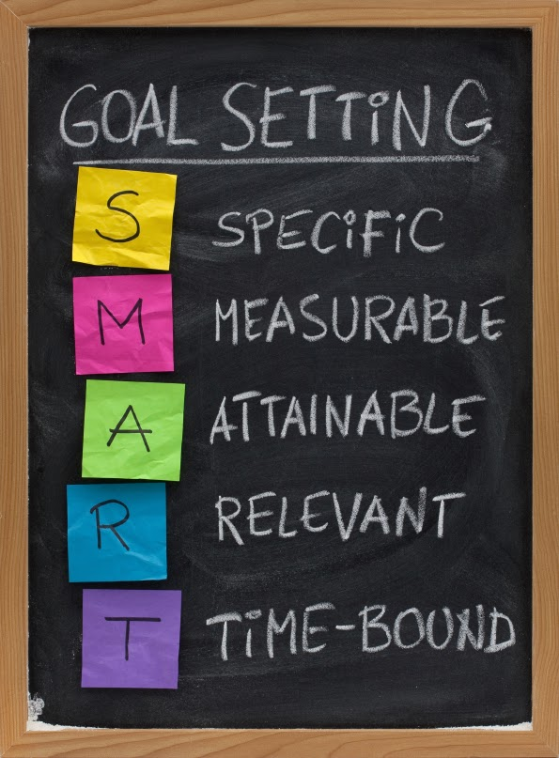
Creating SMART Person-Centered Goals
Notes:
Welcome everyone. In order to accomplish our goals, we need to get started on time, so welcome to Creating SMART Person-Centered Goals.

Slide 2
Objectives
Understand the SMART acronym and how to apply it in your care planning practice
1
Learn techniques to convert identified needs into SMART person-centered goals
2
Identify common pitfalls when creating SMART person-centered goals
3
Notes:
The objectives for today include the following:
Understand the SMART acronym and how to apply it in your care planning practice
Learn techniques to convert identified needs into SMART person-centered goals
Identify common pitfalls when creating SMART person-centered goals
Create a SMART person-centered goal
What we will not cover is how to complete the Collaborative Care Plan and we won’t be completing a care plan today. All the health plans have a slight variation in how we want the CCP completed, however, we all agree on what a SMART person centered goal should look like. This variation is based on our varying Models of Care and each health plans audit experience. Focus is on the goals section of the care plan.

Slide 3

Policy Drives Person-Centered Approaches
CMS and DHS
  CMS Home and Community-Based Services Rules
  Minnesota Statute 245D
  Americans with Disabilities Act (ADA) and the Olmstead decision
  Minnesota’s Olmstead Plan
Notes:
How did Person Centered come to be?
You are likely already familiar with these policy drivers but they are worth mentioning again there are several CMS/DHS policies in place. These policies are the reason Person Centered practices were implemented and made a requirement by DHS.
Person-centered practices are the cornerstone of Minnesota’s Olmstead Plan. Not only are these practices state requirements, they also come from federal authorities like CMS. If adopted and practiced across our system, the intended results will be people making informed choices for themselves and living a higher quality of life.
(Source: Age Odyssey presentation slide 10 and protocol page 1)
The use of person-centered principles and practices is a way of assuring that people receiving HCBS services have the same rights and responsibilities as other people, including having control over their lives, making their own choices, and contributing to their community in a way that makes sense for them.
Person Centered practices ensure that the people we serve get to live the life they choose and desire which are also meaningful to them and controlled by them, not the system.

Slide 4
Person-Centered Concepts
“The individual’s goals should drive care coordination, but to be effective, person-centered care management also requires effective communication and coordination amongst the individual, their health care providers as well as paid and unpaid supports.” -National Committee for Quality Assurance (NCQA)
Care Coordinators (CC), responsible for helping members with their medical and long-term service and support (LTSS) needs, must understand what is most important to the members
CCs must also have an effective system for supporting members preferences and goals when coordinating care with others supporting the member. The CC is often at the center of HOW that care is coordinated.
Notes:
Jenny
Person centered care begins with the individual members goals and is intended to respect and address their preferences and needs.
Person centered care planning places the member at the center of WHAT care is to be provided, by WHOM and WHEN, the care coordinator is often the center of HOW that care is coordinated. Effective COMMUNICATION is key. This communication starts with the member and their identified interdisciplinary care team. The goal is to move forward from care coordinator/provider centered instruction to person-centered participation in goal creation and attainment.
During the Health Risk Assessment Care Coordinators use their interviewing skills to come away with an understanding of what truly is most important to the member and what the member wants.
We know that creating such a seamless and well-coordinated system is anything but simple.

Slide 5
Pitfalls of Creating Goals
Members who are not used to thinking in terms of goals may find this challenging
Members focus on negative issues
Members desired goal may not be attainable or realistic
Care plans have too many goals
Goals are ‘canned’, not individualized, without member specific supports or interventions listed
Carrying over goals from year to year without close review and updating
Using abbreviations and clinical language that the member may not understand
There may be barriers to achieving the goals
Notes:
Jenny: We know there are challenges that Care Coordinators face daily when attempting to create person centered goals.
Lets start with the member
Many of our members may find creating goals challenging. For some it’s something they have never done before. For others they don’t want to draw attention to areas they have difficulty because they want to remain where they are. Often they will tell us: “I have everything I need”. (which we know as care coordinators may or may not be the case).
Then we have a few that may be a little more focused on more negative issues in their lives. It is difficult to create positive outcomes based off a negative goal.
Some goals may not be attainable or realistic. Members statements may be broad/vague “I want to stay in my house”. “I want to be healthy”. “I want to stay safe”. As a Care Coordinator, how do we know what the member feels is needed to reach these goals. Our view of what is keeping them home, healthy, and safe may not be their view of remaining at home, being health, and safe.
We are aware that a few of our members may have MANY more needs identified on the Health Risk Assessment than others. Think about it… If I was your care coordinator and we just complete your assessment and in review I told you that I came up with oh say… 20 goals for you to reach…you may be slightly overwhelmed. We need to consider if the identified need is realistic and attainable based on what the member identified as important to them.
We know that one service doesn’t fit all in our membership. It’s important to focus on the identified barriers to make sure that the interventions that have been agreed upon will address the member’s needs. Think about someone that needs assistance with meal preparation. Figure out what the assessed need is, what the barriers may be, and consider creating an individualized goal to meet the member’s needs. This is when we need to become creative and think outside of the box to ensure we are meeting the members identified needs.
Identified goals may remain an issue from year to year. Some supports we have set up may not have been successful in reaching our goal. There may be opportunities identified to update supports needed to work towards closing goals.
And finally, as healthcare professionals, we speak, read, and write in clinical language and use a lot of abbreviations. Many of our members do not understand words like CC, PCP, SNV, DME, PRN. We have to remember these are the members care plans and they are only of benefit if it can be understood what the needed action steps are and who needs to do them.
We know there are common challenges that Care Coordinators face daily when attempting to create goals. We are hopeful that by the end of this session that some of the tips we present will assist you in overcoming these pitfalls.
Next we will have Kim speak a little on SMART Goals

Slide 6

Developing SMART Goals
SMART goal development was developed by George T. Doran
  Specific
  Measurable
  Attainable
  Relevant
  Time-Bound
Notes:
Kim:
So far, we have reviewed the requirements for person-centered goal planning and have discussed some of those common barriers that you may encounter when developing goals for the members care plan. Now we are going to move into giving you some information that will help you develop some skills related to developing person-centered goals. The first area we will discuss is using SMART goal development.
Creating a SMART goal is not a new concept, in fact, it was first introduced 37 years ago in 1981 by George T. Doran. George was a consultant and former Director of Corporate Planning for Washington Power Company who published a paper titled ‘There’s a SMART Way to Write Management Goals and Objectives” . The SMART goal development is widely used in the business industry as well as the health care industry. We will be reviewing the acronym one letter at a time.

Slide 7
Writing a SMART Goal:
Specific:
State the goal clearly; use a person-centered statement
“I would like to stay in my home”
Not Specific
Using Motivational Interviewing Techniques is a great way to elicit goals and get Specific. Care Coordinators need to help members articulate their goals.
Notes:
77Before we can write the goal we need to identify the goal. What is it that the member is wanting to achieve? This is also where your person centered planning comes in. You have completed the Heath Risk Assessment. There are many areas from the assessment where you can identify their needs/gaps in care and their wishes. The ART of care planning is to try and relate the assessed needs from the HRA to what the member is wanting to achieve.
First you want to get the goal to be Specific. As care coordinators we often hear the goal of ‘I want to stay in my home’. This is a great goal, but it isn’t specific. You should be asking additional follow up questions that will help drill down to more specific goal. You’ll want to answer the question, “How are we going to accomplish this?” In addition, you now know the assessed needs and member wishes you just learned during the assessment. From there you can begin using using your Motivational Interviewing techniques to drill down to a more specific goal.
Use open-ended questions to solicit specific feedback from the member. For example: What is preventing you from staying in your home? What things are you finding the most challenging about staying in your home? Asking the Open-ended questions will help them think about and articulate in greater detail the barriers or difficulties that they are experiencing. Which in turn helps both of you drill down to more specific areas that you can focus on for goals.
Use reflective statements: For example. You have just met with Sam who told you during the assessment that his goal is that he wants to stay in his home. During the assessment you found he is a heavy smoker, has Congestive Heart Failure, is having trouble sleeping, his diet is terrible and he is experiencing financial constraints. An example of a reflective statement would be: As we talked through how you manage day to day activities, you expressed that preparing meals is difficult because you are tired and short of breath so it’s easier for you to eat a bowl of cereal for lunch. We have discussed that is not a healthy choice for your congestive heart failure. During your assessment you also expressed some concern about the cost of cigarettes and you are having some difficulty making ends meet. You stated that you think that quitting smoking would significantly improve your financial situation. Using reflective statements helps you drill down to more specific areas of concern that the member could focus on related to staying in his own home.
In Sam’s case Fatigue, shortness of breath/CHF, diet, cigarette smoking, financial problems. These are all areas that you can focus on for goal writing.
Summarize: Summarizing is another way to get them to start thinking in terms of more specific goals. You would like to stay in your home and in reviewing the assessment we just completed together, your areas of need would be to, get started on a heart healthy diet for your congestive heart failure and to increase your energy and improve your mental health by improving your quality of sleep, and quit smoking which would help your CHF and financial concerns. All of these ultimately will help you stay in your home.
By using MI techniques such as open ended questions, reflective statements and summarizing, you are able to tie the results of the HRA into a specific goal that matters most to the person and their specific situation.

Slide 8
Writing a SMART Goal:
Measurable:
What | How Measured
Smoke no more than 10 cigarettes per day | Self report
Improve mental health by sleeping 4-6 hours/day | Self report
Congestive Heart Failure to remain stable by not gaining more than 5 lbs in 3 days | Clinic records; self report
Notes:
Now, let’s move on to the M of SMART goal development.
Not only should goals be specific, they also need to be measurable. You need to be able to monitor progress and outcomes of the goal and having measurable goals will give you something to measure to determine whether they are progressing towards meeting the goal.
When you are developing a goal with the member, ask this question, ‘How am I going to measure this goal?”
We want you to start thinking about measurable terms when developing the goals.
The way you do that is to identify and quantify the observable markers of progress. Use measurable verbs or measurable rates. For example pain levels or number of days walked each week.
Use Measurable verbs:
Take, perform, complete, use, list, state, self-report, identify, etc.
Measurable rate:
3 days a week, 10 minutes a day, 80% of the time, 8 out of 10, or if there is a goal related to lab values you can use that (self report if no access to labs) ??A1c for example?
An example of a measurable rate could be the Pain scale– faces. Some of you are likely already familiar with this pain scale. This pain scale could be a way, for someone with a goal of reducing their pain to be able to measure their progress on it. For example: Martha will rate her pain as < 4-6 1x/week. UCare developed this version which includes several different languages. We thought it would be a good resources for you today.
To summarize-- Having a measurable goal will allow you to quantify how well the person is doing in meeting the goal.

Slide 9
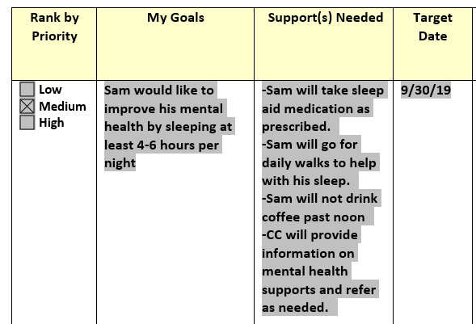
Measurable Goal:
Measurable Goal
Notes:
Here is another example of a measurable goal. Sam wanted to stay in his home. Assessment was shown to have difficulties sleeping which was contributing to his fatigue during the day. So he didn’t have the energy to fix a healthy lunch. Sam and Care Coordinator started working on his sleep issues for one of his goals.
Read the Goal and Supports.
Your measurable rate here on this goal is 4-6 hours of sleep.

Slide 10

Writing a SMART Goal:
Attainable:
Break the goal into smaller, actionable steps. Identify expected barriers and decide to address them.
Notes:
Now we are moving on to the next letter in our SMART goal format and that is A for Attainable. The goal must be attainable. For example many of our members may want to quit smoking or lose 60 pounds. But we know that it isn’t easy and that just isn’t going to happen, at least not overnight. Or, it may not be realistic for everyone. Having unattainable goals may be overwhelming and the person may just give up.
It is better to break it down into more attainable goals.
Think about using smaller actionable steps in getting to goal.
In our example earlier, Sam was having some financial concerns and stated that the cost of cigarettes was breaking his bank. He is motivated to quit smoking in order to improve his finances which in turn will help him stay in his home.
As the health plan Care Coordinator you also know that quitting smoking will benefit his health as well and of course would encourage a healthy goal such as quitting smoking. But you also can help them make them smaller and more attainable.

Slide 11
Not attainable – attainable goal
Not attainable | Attainable
I want to be smoke free | Sam would like to smoke no more than 10 cigarettes per day
Notes:
Here is an example of a goal that may not necessarily be attainable next to a goal that is more attainable.
Here you can see that this goal feels more attainable. It is much more attainable to think about reducing to 10 cigarettes per day versus quitting cold turkey.
In addition, to remind you this goal is also more specific. And the goal is measurable because we are using measurable rates of reduction to 10 cigarettes per day.
And, you will more easily be able to monitor progress on the goal by measuring number of cigarettes per day
To summarize: The person will be more likely to succeed if they are working on more attainable goals.

Slide 12
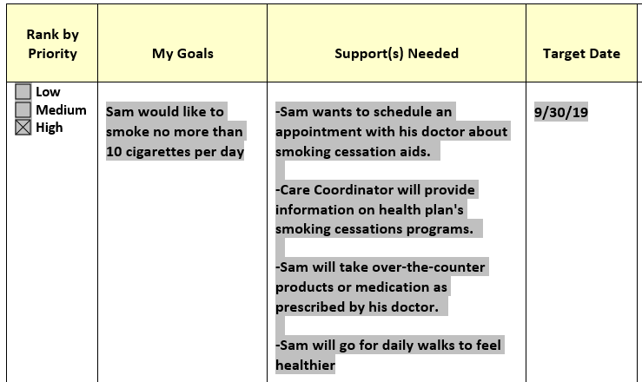
Attainable goal with supports
Actionable Steps
Attainable Goal
Notes:
Here is an example of an attainable goal.
We’ve included actionable steps. We we will be going into more detail about developing actionable steps used with your Supports and interventions in future slides.
Now I’m going to hand it over to Leah from PrimeWest who will cover the rest of the SMART acronym.

Slide 13
Writing a SMART Goal:
Relevant
Make sure the goal reflects what’s important to the individual. Use Motivational interviewing to help tie identified needs from the assessment to goals.
Why is this goal important to the member?
How will this goal benefit your member?
Will the member stay committed to the goal?

Slide 14
Writing a SMART Goal:
Time-Bound:
Define the period in which the goal is to be attained and agree when to check progress.
Is this a long or a short term goal
Prioritize by importance, put “first things first”
Schedule the time to follow up reviewing progress
Are there things that could prevent goal from being completed
Notes:
When setting the time frame in which the member will complete the goal make sure you are keeping in mind members individual’s preferences, potential barriers or actual barriers.
I was thinking I would cover this verbally letting CC’s know there are a few different care plans used and need to filling the appropriate areas of each health plans’ care plan, including target date, all follow up/monitoring and goal outcome.
Here is the start of some talking points Some of the talking points for “T”:
•As a CC/CCM you will make sure there is a target date, but make sure you are discussing with your member the realistic time frame it will take to accomplish the goal. If the time frame is longer than 12 months then break this down into a short-term goal to assist in accomplishing the long term goal.
•Once you have decided on the length of the goal you will then look at prioritizing what should be the done first and looking at what’s important to the member and for the member.
•Following up with the member on their goal is another important part. You want to make sure the goal is still obtainable and realistic for the member. If a member is not making progress toward the goal it may need to be modified adding new interventions or does there need to a new goal and this one removed?

Slide 15
Supports and Interventions
Document any intervention(s) related to achieving the goal
What will the member need to accomplish the goal
Who will help the member achieve the goal
Formal/informal supports
Can have multiple interventions for one goal
Notes:
We have talked about goals being Specific, Measurable, Attainable, Relevant and Timebound. We are now going to talk about the supports and interventions part of goals.
It is important to remember when recording supports and interventions that specific people are identified who are providing the actual support. This is an Audit element requirement for all health plans.
When formulating supports and interventions, help the person consider the barriers or obstacles they may encounter, the material items needed for the goal and the physical and psychological supports that would be helpful to drive the goal forward. Ask the person who are positive and supportive people in their lives who can encourage them and supply needed supports and materials that will help them continue working on their goal even when they are “not feeling like it” or stopped working it all together. The person may find they are spending more time with people who are reinforcing their goals-this is a natural consequence. Adding several interventions for each goal can help improve the likelihood of success for the person. It gives the member concrete steps to follow and slowly reinforces them to reach out for supports in a meaningful way.
It is also important to review your supports and interventions whenever you review goals with your member. For example if Sam’s sister can no longer attend his diabetic appoints with him it would be important to find someone else to take her place and update the supports and interventions to reflect this. This will show you are reviewing the goal, making needing changes and planning for the implementation of these changes.

Slide 16
Supports and Interventions: Examples
Sam’s daughter will remove scatter rugs throughout the house
Sam’s sister will attend doctor’s appointments with him
Sam’s home care nurse will visit weekly to fill his medication dispenser
Sam will use a safety pendant to alert family if he falls
Sam will schedule an appointment with a dietician at his clinic to discuss nutrition and meal plan
Care Coordinator will provide smoking cessation information and mail to Sam
Notes:
Some examples of supports and interventions would be: Sam’s daughter will remove scatter rugs throughout the house.
Sam’s sister will attend doctor’s appointments with him. Sam’s home care nurse will visit weekly to fill his medication dispenser.
Sam wants to use a safety pendant to alert family if he falls. Sam wants to schedule an appointment with a dietician at his clinic to discuss nutrition and meal plan. Care Coordinator will provide smoking cessation information and mail to Sam.

Slide 17
Goal Creation: Tips and Tricks
Build trust
Respect the individual’s preferences
Listen for cues i.e. excitement about a topic, comments about current struggles or reflections on the past
Motivational Interviewing techniques
Open ended statements
Reflective statements
Summarize
Use Person-Centered language including:
Members name or I statement. Refrain from using “Member”
Would like to, wants to, etc. Refrain from using “will” or “should”
Notes:
Now that you have gathered the information on how to meld the concepts of SMART goals and person-centeredness the next couple slides are some tips and tricks, to keep in mind while creating goals. Your relationship with the member is at the forefront of being able to build well-crafted goals. While you are meeting with the member during the assessment, 6 month visit or phone calls throughout the year, you are using your active listening skills and listening for cues, such as excitement about a topic, or comments about struggles.ADD SOME LANGUAGE ABOUT mi AND WHAT KIM JUST DISCUSSED. A good example would be if a member is excited to visit their grandchildren but they may not be able to play with them due to health conditions – that may be a motivator for them to manage their condition better.
You can think of yourself as the facilitator of the goals and in some cases the key driver especially for members who do not identity any goals. so using open ended or reflective statements and summaries may help guide members to prioritize what's important from the Health Risk Assessment.
You are all probably well versed in person centered language, however some reminders to meet requirements of PC language in the My Goals column, refrain from using the word “member” instead use the members name – Sam – or use the third person “I”. And refrain from using will or should and focus on Sam would like to or I want to…. In the supports needed column of the goals it is appropriate to use will.
Using the teach back method to review what the member wants/desires to ensure you are both understanding what is being written. Also, Review with member how they would like their care plan to be addressed, you can ask – Sam would you like your care plan to say….. Sam would like or I want…..

Slide 18
Goal Creation: Tips &Tricks
Gather
Gather information from the Health Risk Assessment to prompt a goal
Help
Help the member break down broad or vague statements into attainable goals
Being
Being able to craft the answer to express what the member wants yet meet requirements
Encourage
Encourage goals that have the potential for positive health and quality of life outcomes
Promote
Promote self-advocacy and self-realization. Help the member find their ‘can do’ attitude. “You are your best advocate”
Identify and address
Identify and address barriers
Avoid
Avoid Clinical language (PCP, CC, PRN, CHF, SNV, HHA, etc.)
Notes:
As I mentioned in the previous slide you are the key driver to help the member pull the information from the health risk assessment to create specific goals - and when the member has a hard time identifying attainable goals, then you can help them choose something that is relevant – such as – I want to stay in my home. Help them identify what is needed to do that, maybe it means to have nutritious meals and take their medications on time – those could be two separate goals that are relevant to the members situation. In such a broad goal such as I want to stay in my home it is easy to get carried away and create a list of goals that would cover everything that would be needed in this scenario – so it’s not necessary to make 20 goals. you can make 2 or 3 that would cover a broad goal such as this.
Many times you may work with members that tend to be negative, such as I don’t want to go to the nursing home, this is a good opportunity for you to spin it into A POSITIVE GOAL, SUCH AS – I want to stay in my home. Along with this it will be essential to discuss any barriers that may be present during goal creation – and assisting to identify how to breakdown the barriers that can be removed. AND IDENTIFYING BARRIERS WILL HELP YOU GET TO A MORE SPECIFIC GOAL. AS IN KIMS EXAMPLE THE MEMBER NOT HAVING ENOUGH MONEY, CUTTING BACK ON SMOKING WOULD HELP…..
Furthermore it’s important for members to realize they are the owner of their goals – and help them promote self-advocacy and what they want. Helping members advocate for what they want is a part of building care plan goals – so as a Care Coordinator, being able to identify if there are family members or caregivers inserting their own goals or agenda into the care plan. It’s your responsibility to follow the person-centered approach and hear what the members want. So if Sam’s daughter wants him to go to bed earlier, but he has no interest – then listening to the member is best in this scenario. Of course in the scenarios in which a member has a guardian is a little different, as the guardian does have say in the final outcome.
Lastly I want to remind you to Avoid jargon in the Collaborative Care Plan – such as acronyms like PCP, CC, PRN, CHV, CL facility – to name a few.

Slide 19
Pulling it all together
Goal
Active listening
Identify Supports
Person-centered
SMART
Positive goals
Health Risk Assessment
Motivational Interviewing techniques
Target Date/Check-In
Notes:
Putting it all together - - - - - This is where the art and science of goal creation comes together. It’s not only documenting accurately – such as using SMART PC goals, but it’s also using your own professional judgement and experiences to create a relationship with your member to assist in making meaningful and measurable goals.

Slide 20
Not SMART vs SMART Person-Centered Goals
Not Smart or Person-Centered Goals | SMART Person-Centered Goals
Member will stay living in his home | Sam would like to stay living in his home over the next 12 months
Member will lose weight | Sam would like to lose 15 pounds within the next 6 months
Member will be compliant with high blood pressure medications daily | Sam would like to take his high blood pressure medication every morning for the next 12 months
Member will be free from falls | Sam would like to be free from falls for the next 6 months
Notes:
Here are some “Before and After” examples of goals that are “Not SMART” and those that “are SMART.”
In the first example we have “Member wants to stay living in his home” but in the SMART example we have more details, “Sam would like to stay living in his home over the next 12 months” This makes the more specific.
Again in second example the not SMART “Member wants to lose weight” and the SMART, “Sam would like to lose 15 pounds within the next 6 months” This makes the goal specific and measurable
The third example, “Member will be compliant with high blood pressure medications daily” is transformed to , “Sam would like to take his high blood pressure medication every morning for the next 12 months.” making the goal specific. Lastly the unspecific, “Member will be free from falls” is transformed into the SMART, “Sam would like to be free from falls for the next 6 months” This goals is person centered and specific.

Slide 21

Questions?
This Photo by Unknown Author is licensed under CC BY-NC

