Slide 1
Welcome
UCare’s Ongoing Education CEU Event

Slide 2
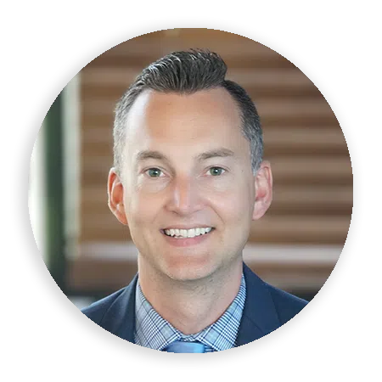
Dr. Glen Rebman, DO, MA
Chief Medical Officer

Slide 3
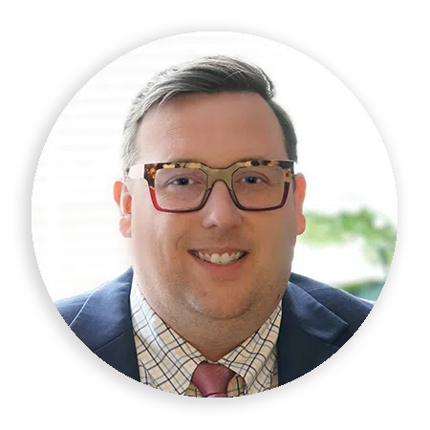
Dr. Daniel Montville, MD
Medical Director

Slide 4
Interventional Psychiatry: The future of the field?
Dr. Dan Montville and Dr. Glen Rebman, 11/14/2023

Slide 5
Disclosures
Relevant financial relationships:
  We have no financial relationships to disclose related to pharmaceutical companies, device makers, or third-party vendors. We have part ownership in a private practice that focuses on interventional psychiatry.
Off-label and/or Investigative Use:
  We will discuss off-label approaches in depression, personality disorders, PTSD, and substance use disorders.

Slide 6
Objectives
Define interventional psychiatry.
Learn about all the interventional treatments.
Better understand depression, posttraumatic stress disorder (PTSD), borderline personality disorder (BPD), and substance use disorders.
Examine and identify the relationship between substance use disorders and mental health disorders.
Discover new ways to treat these common disorders.
Learn how to better navigate these conditions in the mental health care system.
Apply this knowledge to your practice.

Slide 7
Interventional Psychiatry
Emerging field anchored in the past.
Procedural-based treatments to alleviate mental illness.
Includes novel medications like ketamine/Spravato and psychedelics.
Energy and the Brain.

Slide 8
depression
Major depressive disorder and especially bipolar disorder are recurrent illnesses in most patients. Think of them as relapse-remitting diseases. Treatment-resistant depression is a major problem with debated definition (~ 2 failed medications).

Slide 9
PROBLEM
Challenging
Around 30% of patients with depression are treatment-resistant.
Meds failing
Around 10% of US population are on antidepressants, yet rate of depression is climbing.
disabling
Depression is the most disabling condition worldwide.
Morbidity
Patients with depression die on average 8 years earlier. 20 x increased rate of suicide.

Slide 10
TRD
Sequenced Treatment Alternatives To Relieve Depression (STAR*D) study reported the remission rate after each treatment step as follows:
  1st: 36.8%
  2nd: 30.6%
  3rd: 13.7%
  4th: 13%

Slide 11
SOLUTION
BRAIN MODULATION
SOCIETY
Interventional psychiatry
Address American ills
REDUCE TRAUMA
BUILD IT
30% of mental illness would evaporate
New, modernized mental health care system

Slide 12
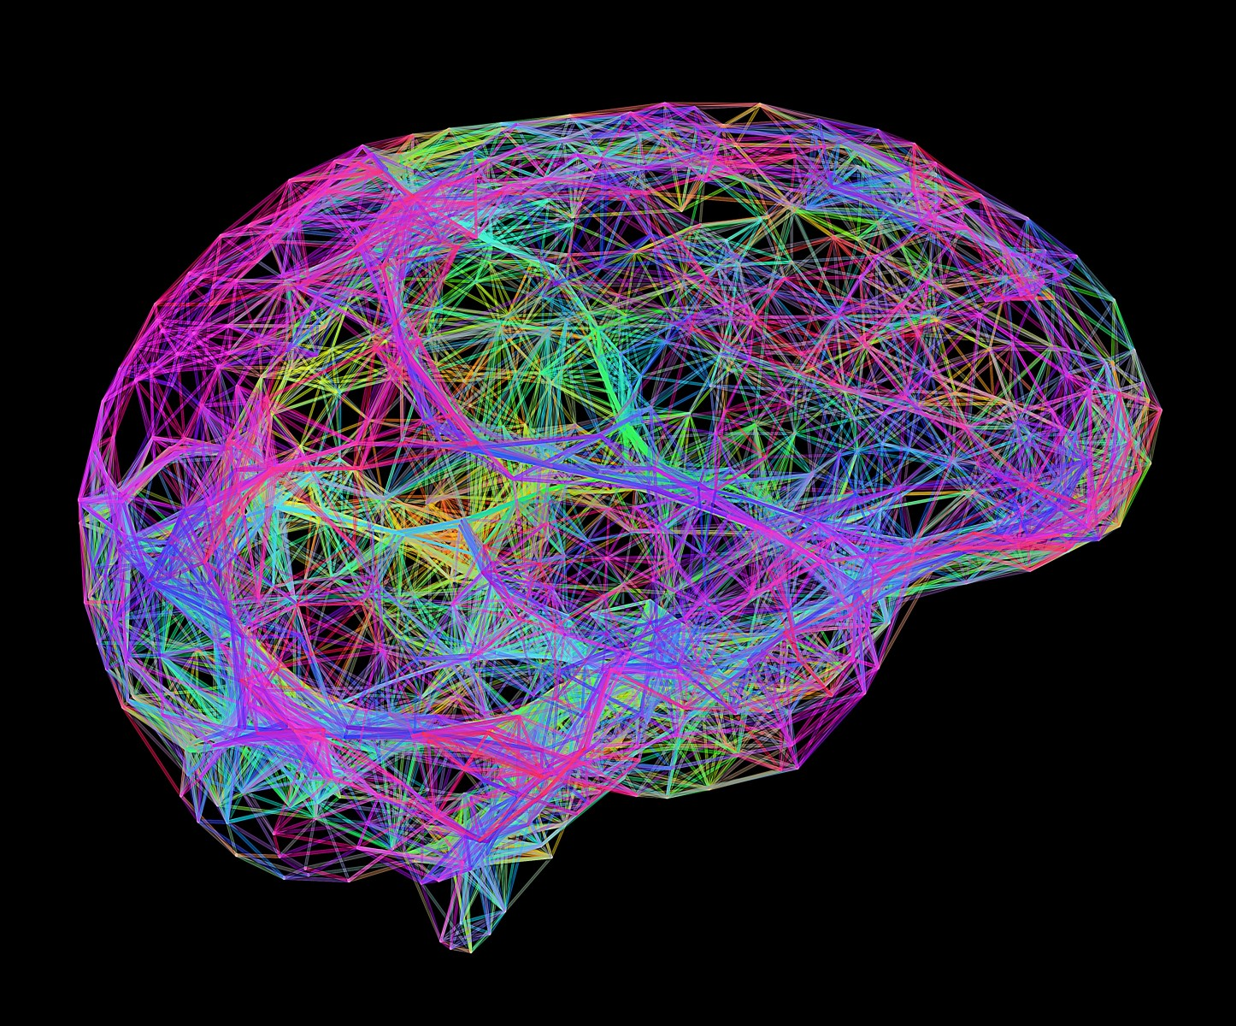
the brain

Slide 13
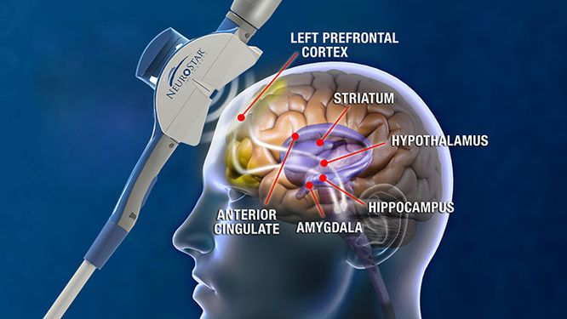
neuromodulation

Slide 14
treatments

Slide 15
ELECTROCONVULSIVE THERAPY(ECT)
Best treatment for depression. Original - 1930s
TRANSCRANIAL MAGNETIC STIMULATION (TMS)
FDA approved in 2008. Like ECT without seizure.
TRANSCRANIAL DIRECT CURRENT STIMULATION (tDCS)
Weakest evidence. At home use.
VAGAL NERVE STIMULATION (VNS)
Most durable of all treatments.

Slide 16
DEEP BRAIN STIMULATION (DBS)
Inaccessible outside of research studies.
KETAMINE
Old drug repurposed. Fast and effective.
SPRAVATO
2019 FDA approved form of ketamine. Can be less effective than IV ketamine
PSYCHEDELICS
New frontier. Research study access only unless underground.

Slide 17
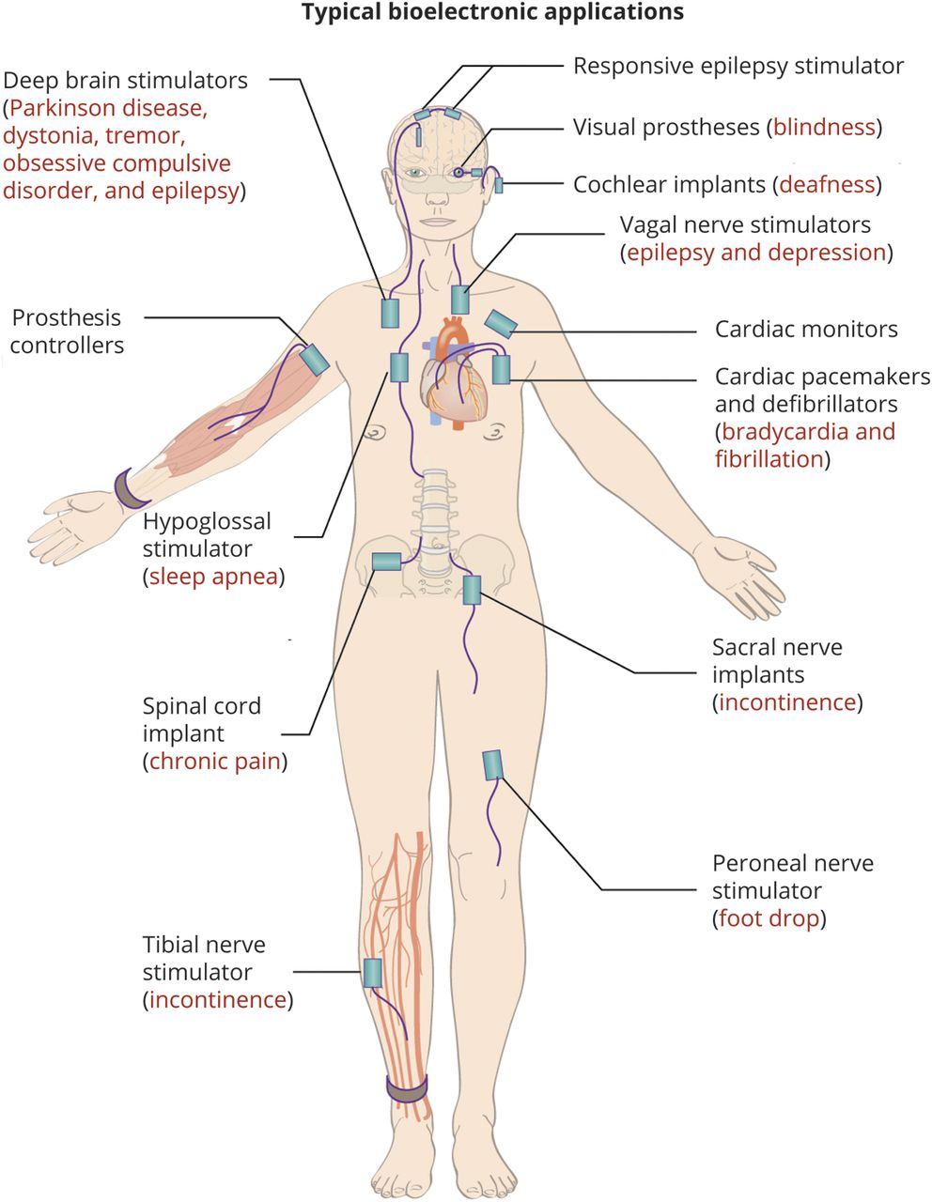
Denison T, Morrell MJ. Neuromodulation in 2035: The Neurology Future Forecasting Series. Neurology. 2022; 98(2):65–72.

Slide 18
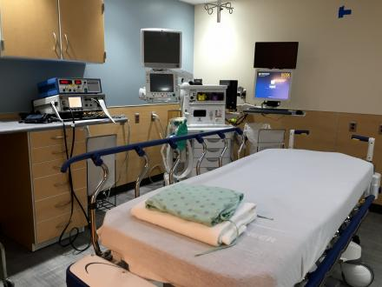
ECT
Gold standard for depression.
Oldest and most effective.
Treats widest number of conditions.
One of the safest medical procedures.
Underutilized.
Cost-effective (~$10K).
Hard to find

Slide 19
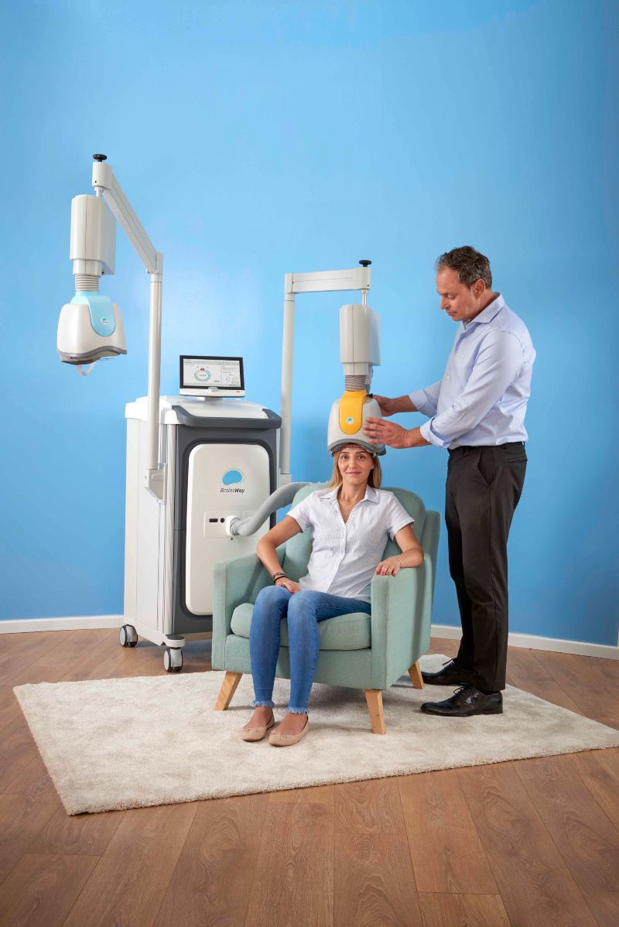
TMS
Researched in 1980’s. FDA approval in 2008.
Expanding use.
Extremely safe.
First line treatment?
Time commitment.
Geographic restriction.

Slide 20
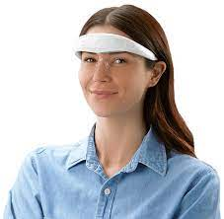
Tdcs
Weak current to scalp, cranial nerves and/or ear.
Indications: depression, anxiety, sleep, agitation, and stress.
Multiple products- Fisher Wallace and Alpha-Stim most well known.
Small evidence.
Less effective.
At home use. Online purchase.

Slide 21
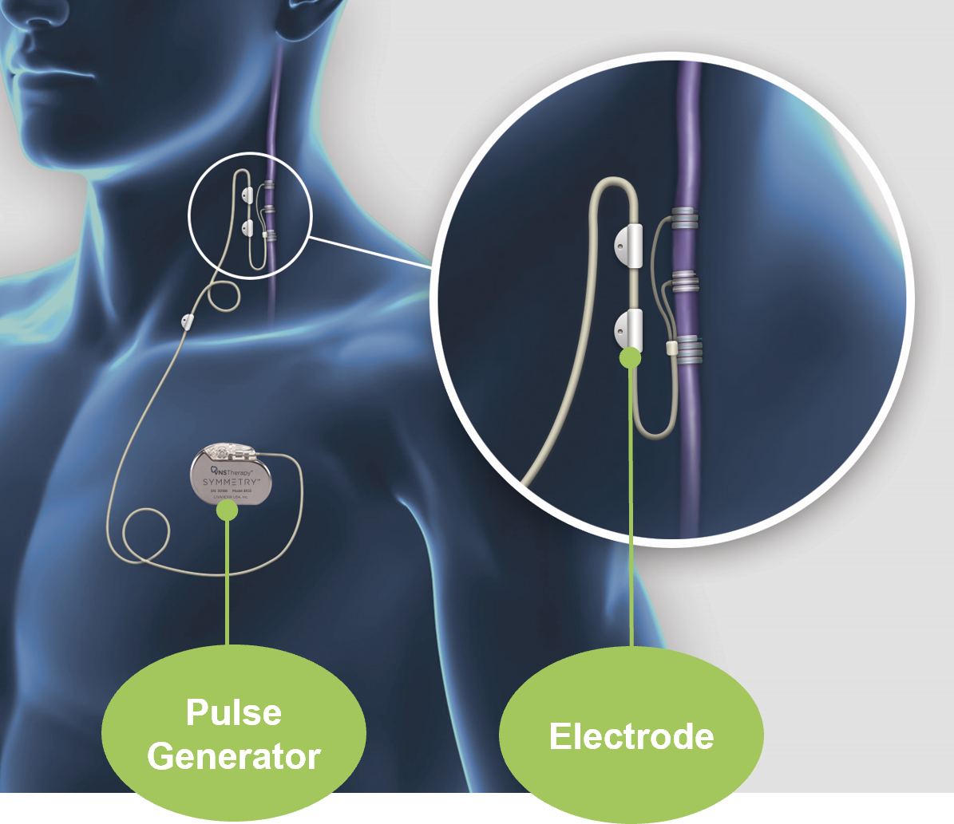
VNS
FDA approved in 2005.
Works when others things don’t.
No issues with compliance.
Slow cooker.
Effective for bipolar depression.
Hard to get insurance approval.
Requires neurosurgeon to implant.

Slide 22
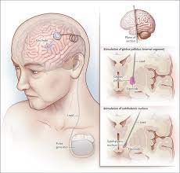
DBS
Multiple neurological indications.
Experimental for depression.
Most risk.
Recent research studies for depression have shown less efficacy than hoped.

Slide 23
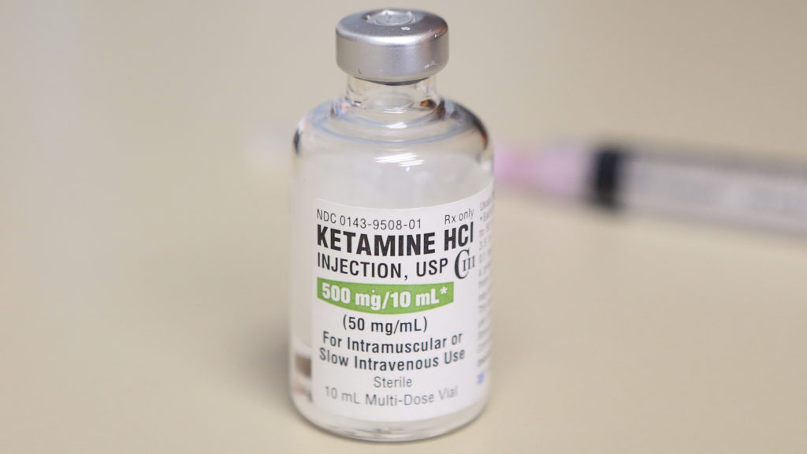
Ketamine
1960s drug, new life in last 10-20 years.
Rapid-onset, anti-suicidal.
Indications: depression, OCD, anxiety, PTSD.
Multiple routes: Troches, intranasal, IM, IV.
Works fast, just doesn’t last.
Recent study showed as effective as ECT, although study limitations.

Slide 24
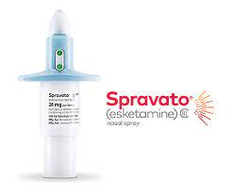
Spravato
Intranasal, S-enantomer.
Antidepressant augmentation.
Cumbersome REMS program.
Available in more rural locations.
Can be as effective as IV ketamine.

Slide 25
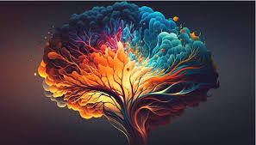
Psychedelics
Old/new frontier.
Fast and effective.
Limited dosing - a couple times a year?
Indications: depression, anxiety, PTSD, substance use disorders, and others.
Psilocybin and MDMA most promising.
Generate experiences of awe – rate as most important experiences of life!
All about the setting!
FDA approval: next few years?
Research only unless underground or out of country.

Slide 26
efficacy
ECT: 80% response/60% remission.
TMS: 60%/30%.
tDCS: 40%/25%?
VNS: 60%/40% at 5 years.
DBS: 60%/30%?
Ketamine: 65%/35%.
Spravato: 50%/35%.
Psychedelics: 70%/40%.
*Percentages rounded for ease based on best guess from data with the specific patient affecting efficacy*

Slide 27

How to use

Slide 28
What can I recommend to patients for depression?
TMS for all. Ketamine/Spravato if not interested in TMS, sicker, or need to get well sooner.
tDCS if more worried well and not interested in meds or TMS.
ECT if acutely ill.
VNS, DBS, and psychedelics (all likely need research study) for severe, treatment-resistant depression.

Slide 29
Where to find?
TMS, Ketamine/Spravato: Interventional clinics like The Remedy. Mostly in metro.
tDCS: Buy online or through a psychiatrist.
ECT: Hospital systems.
VNS, DBS, and psychedelics: Interventional clinics like The Remedy and universities like the University of Minnesota.

Slide 30
Don’t forget
Psychotherapy
Exercise
Diet
Relationships
Community
Neutraceuticals
Spirituality
meaning
Gratitude

Slide 31
Questions?
What have you found most challenging about caring for patients with depression?

Slide 32
Co-Morbidities

Slide 33
borderline personality disorder (BPD)
BPD is common for patients with depression (~28% of patients with persistent depressive disorder). Patients with BPD have a high rate of depression (~50%, some studies show as high as 83%). Depression in patients with BPD can be more challenging to treat. Almost all patients with this condition have dysphoria.

Slide 34
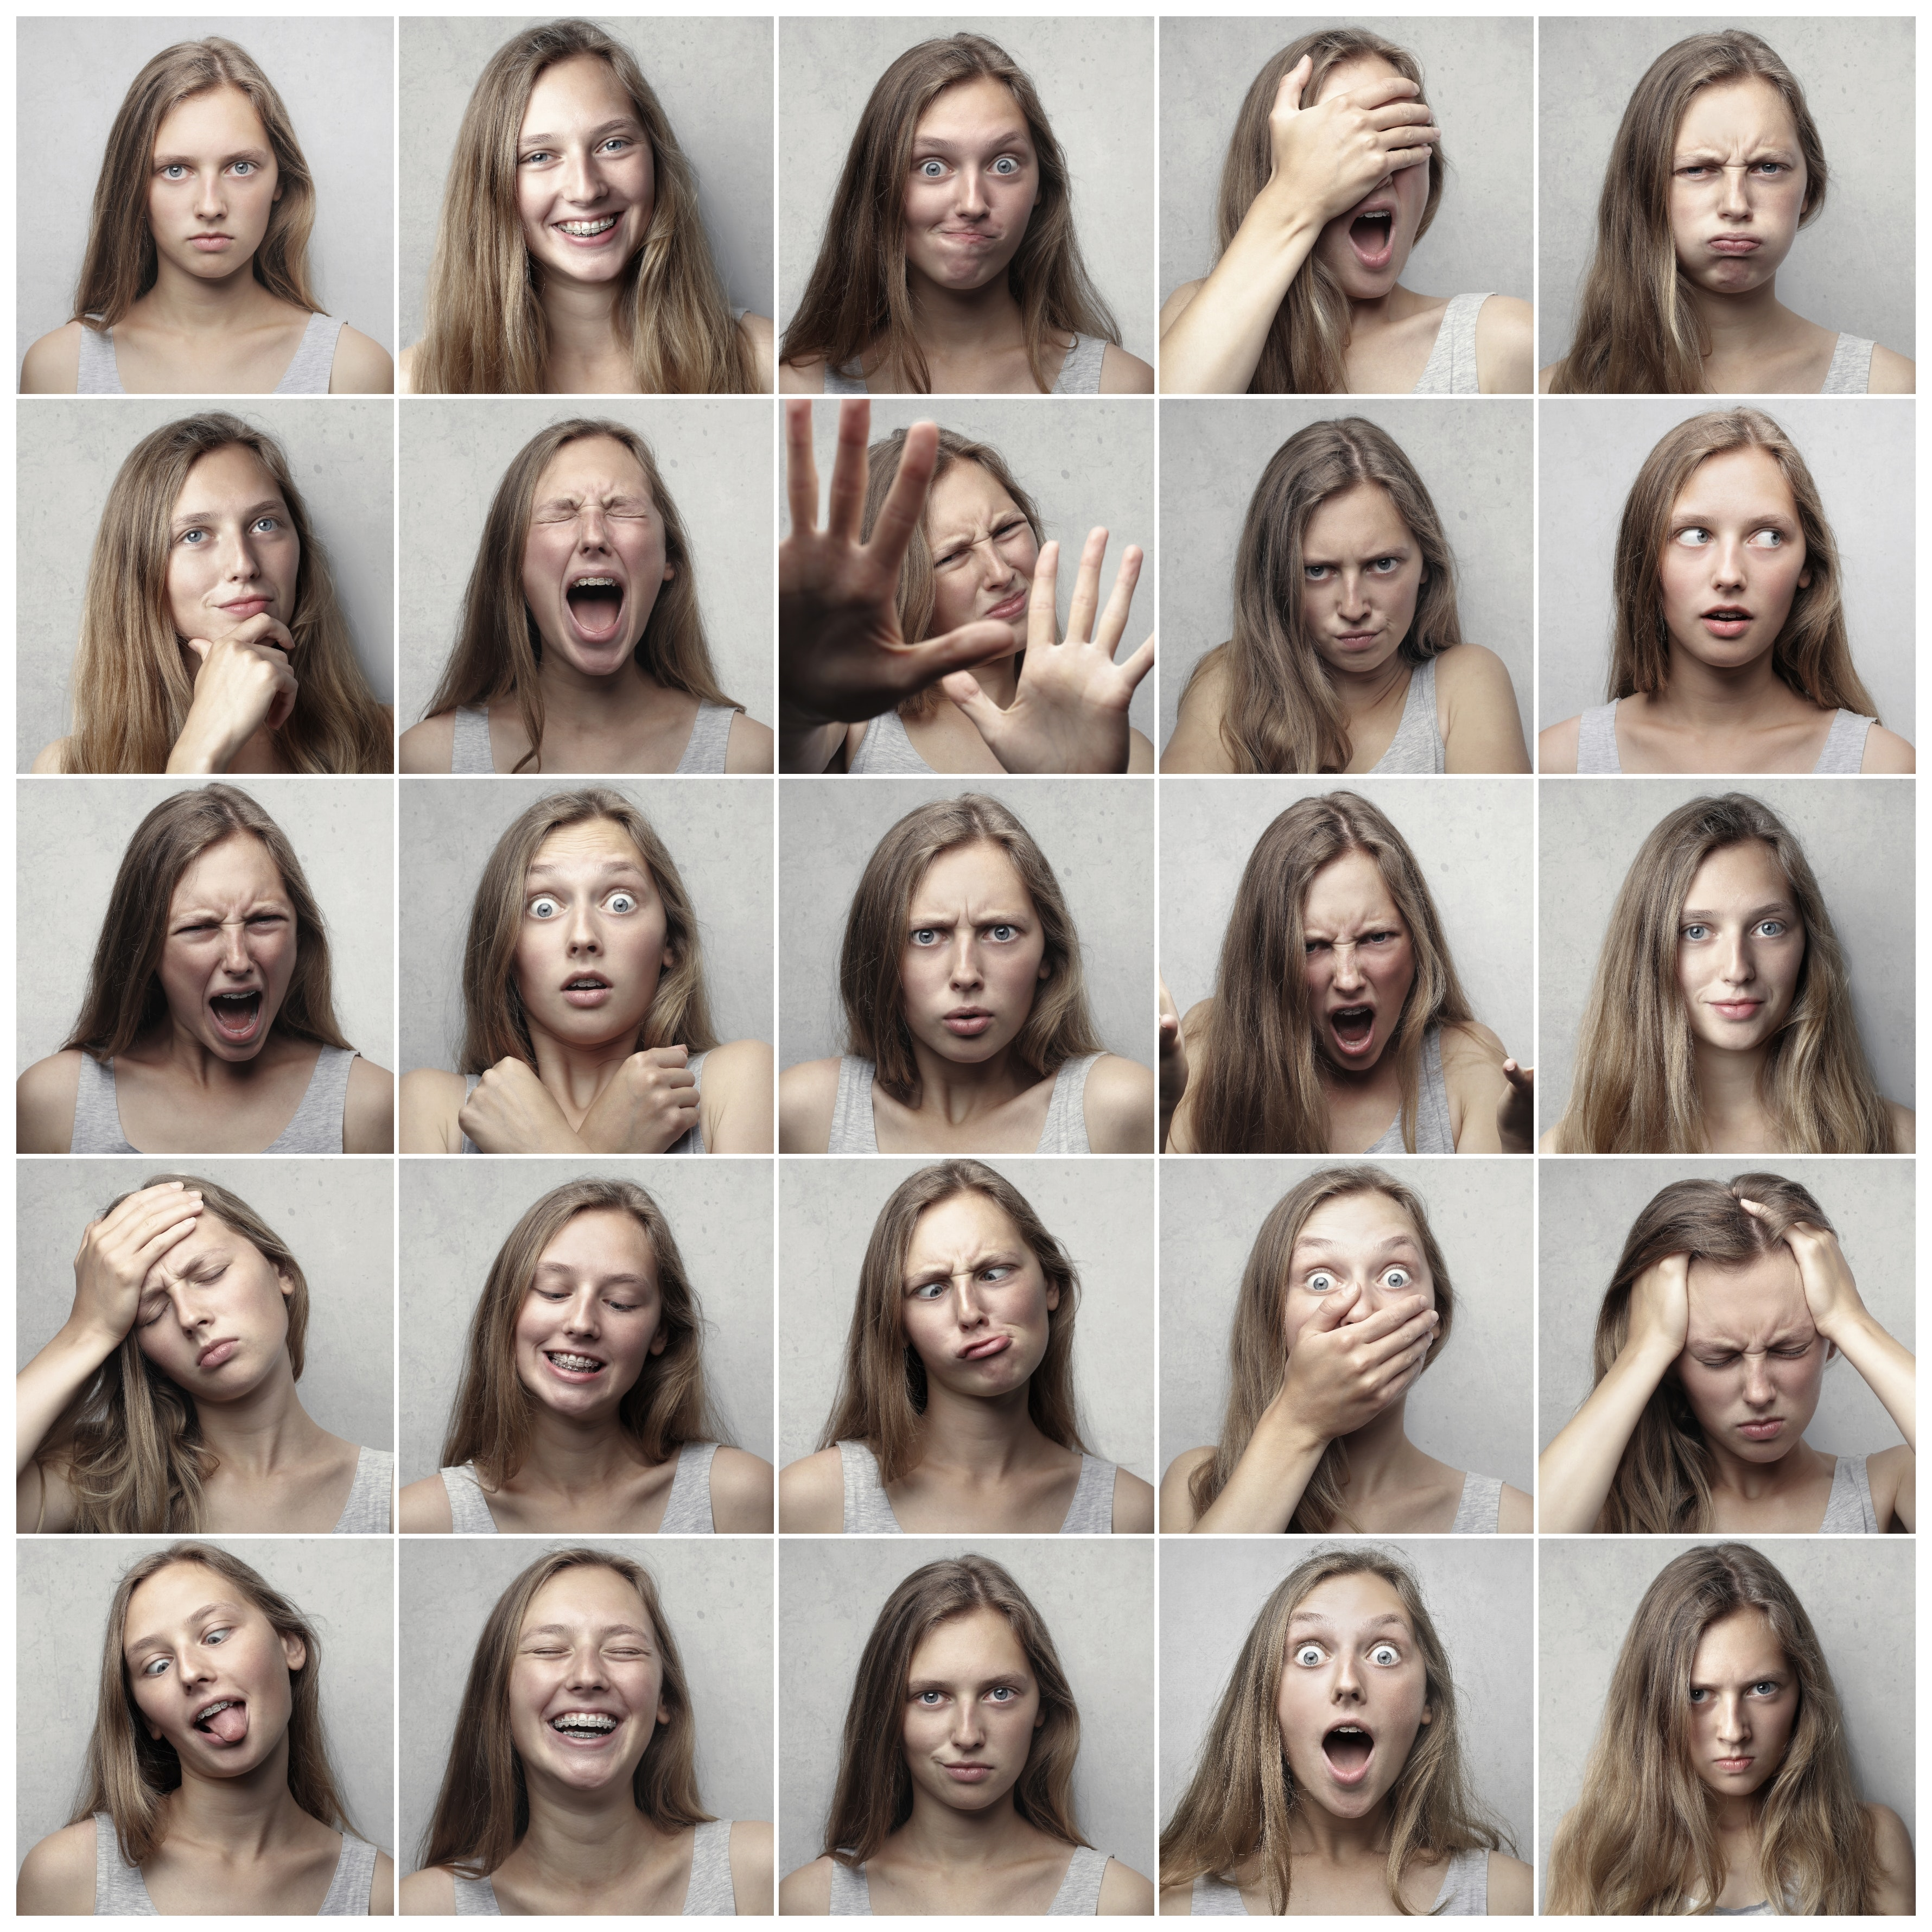
Deficit in self-management and emotional regulation

Slide 35
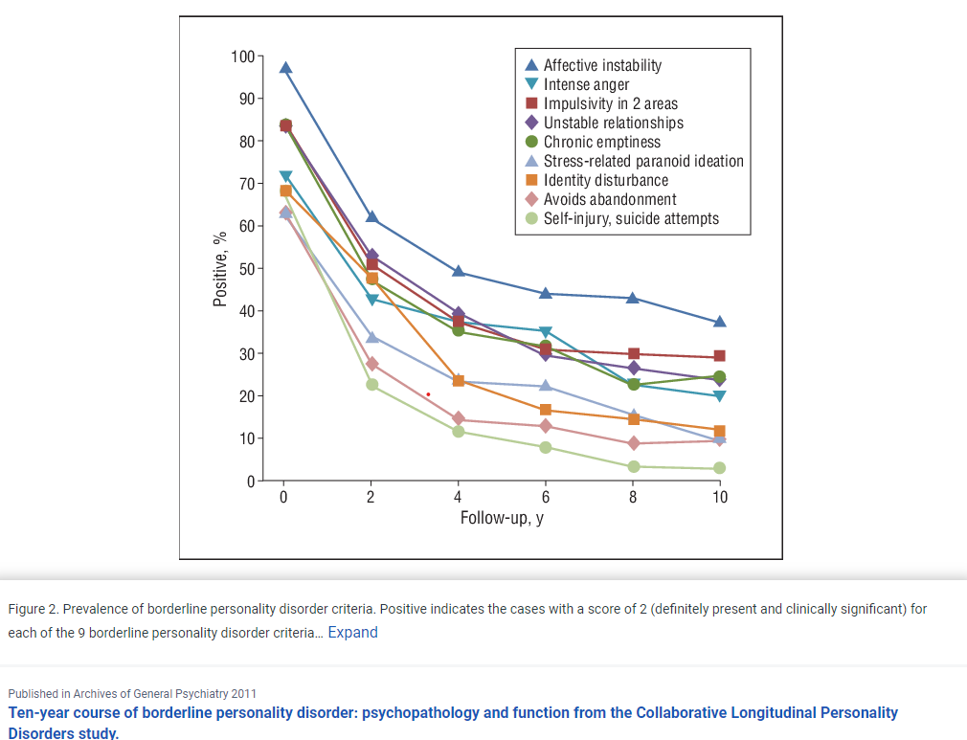
Hope in despair

Slide 36
Common myths
BPD is a lifetime diagnosis.
BPD only happens in women.
BPD is the result of bad parenting.
Patients with BPD are hard.
Medications don’t work.
Fixing depression will fix BPD.

Slide 37
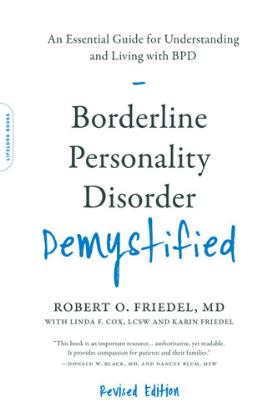
Helpful resource

Slide 38
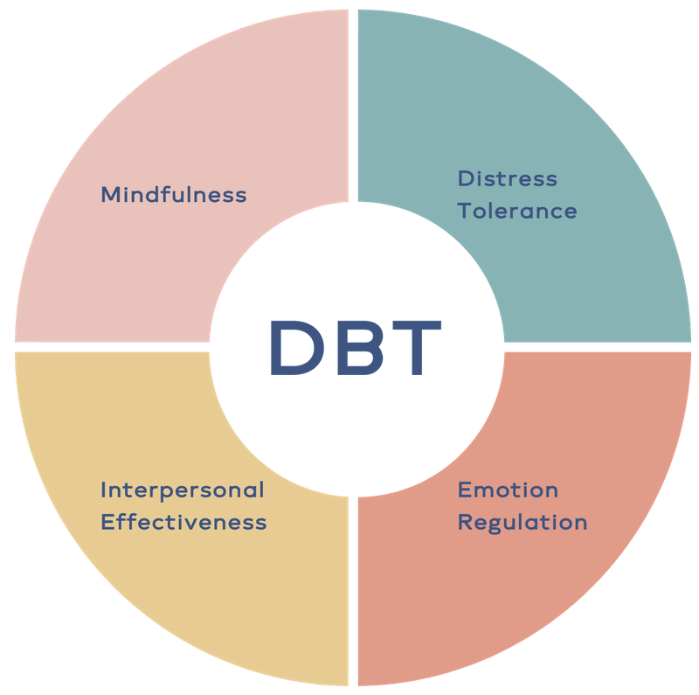
Treatment

Slide 39
Other therapies
Transference-focused psychotherapy
Psychodynamic
Mentalization-based treatment
Schema-focused therapy

Slide 40
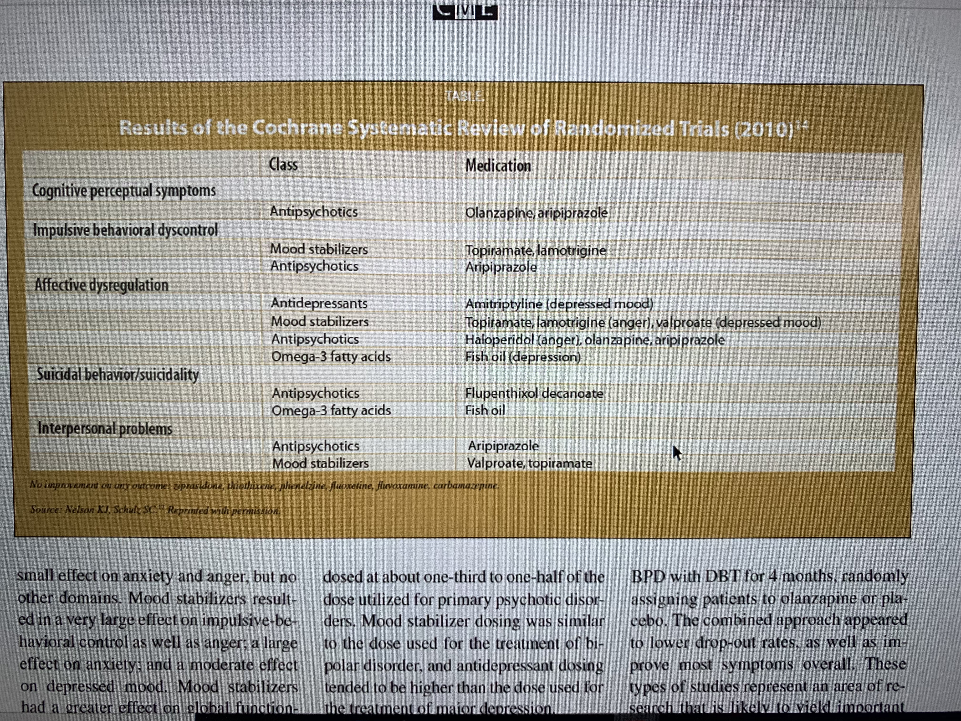
medications

Slide 41
Interventional treatments
Principle of treating BPD prior to treating depression.
Interventional treatments are used to treat depression in BPD.
Reduced likelihood of efficacy.

Slide 42
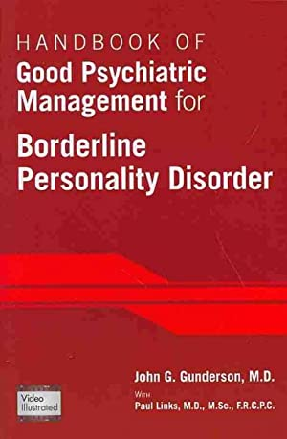
Non-specialized Treatment

Slide 43
Questions?
What treatments have you found most effective for BPD and depression in BPD?

Slide 44
Posttraumatic stress disorder

Slide 45
Posttraumatic stress disorder(PTSD)
1 in 11 people will be diagnosed in their lifetime. Twice as likely in women. Higher rate in US Latinos, African Americans, and Native Americans/Alaska Natives. Different types- acute vs chronic. Effective treatments exist.

Slide 46

Life is traumatic

Slide 47
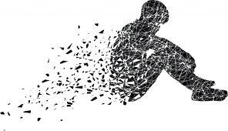
Mind-body, memory-stress system response designed to protect

Slide 48
Time heals for many
20%, 27%, and 50% of cases recovered within 3, 6, and 24 months and 77% within 10 years (the longest duration allowing stable estimates).

Slide 49
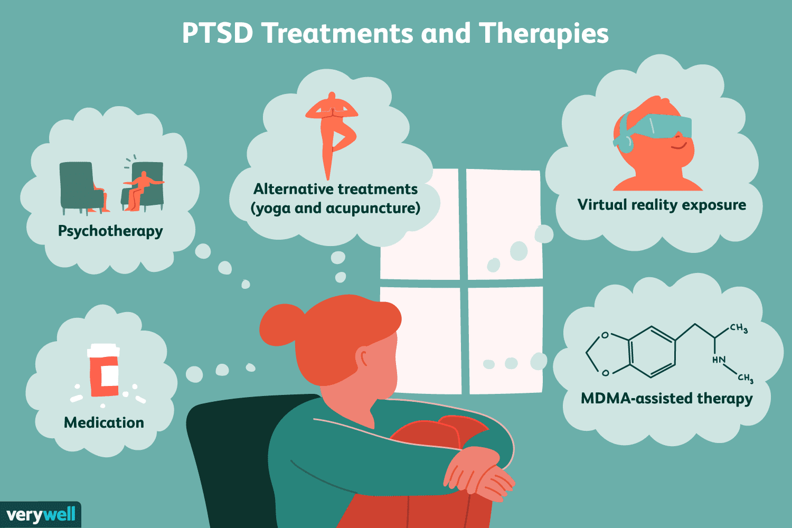
Treatment

Slide 50
therapy
Gold-standard.
Prolonged exposure therapy and cognitive processing therapy can be up to 80% effective, but only 50% complete it. 40% experience worsening of symptoms prior to getting better.
Other options- somatic therapy, eye movement desensitization and reprocessing (EMDR), trauma-focused cognitive behavior therapy, hypnotherapy, and others.

Slide 51
medications
Somewhat similar response rates to treating depression. 1/3 do not respond.
Use multiple classes, off-label, given only Zoloft and Paxil are FDA approved.

Slide 52

Interventional treatments
Ketamine: Evidence to support, although smaller. Study below showed 60% of patient had treatment response (30% reduction in symptoms).
Stellate ganglion block.
Psychedelics: MDMA.

Slide 53
Questions?
What therapies do you find your patients with PTSD being able to complete and benefit from the most?

Slide 54
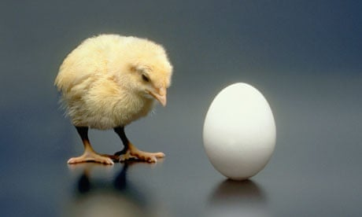
intersection of mental health and substance abuse

Slide 55
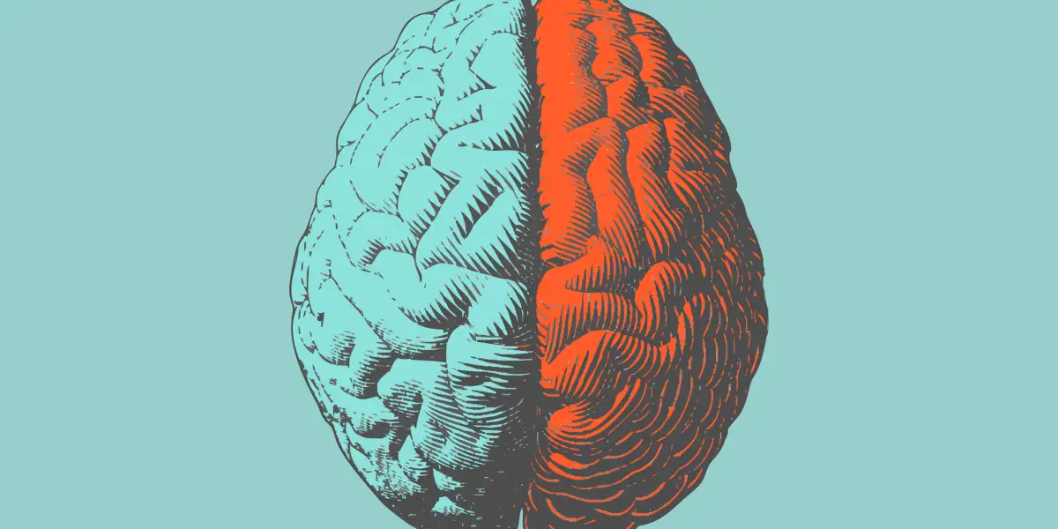
Addiction & YOUR BRAIN:
What IS THE CONNECTION?

Slide 56



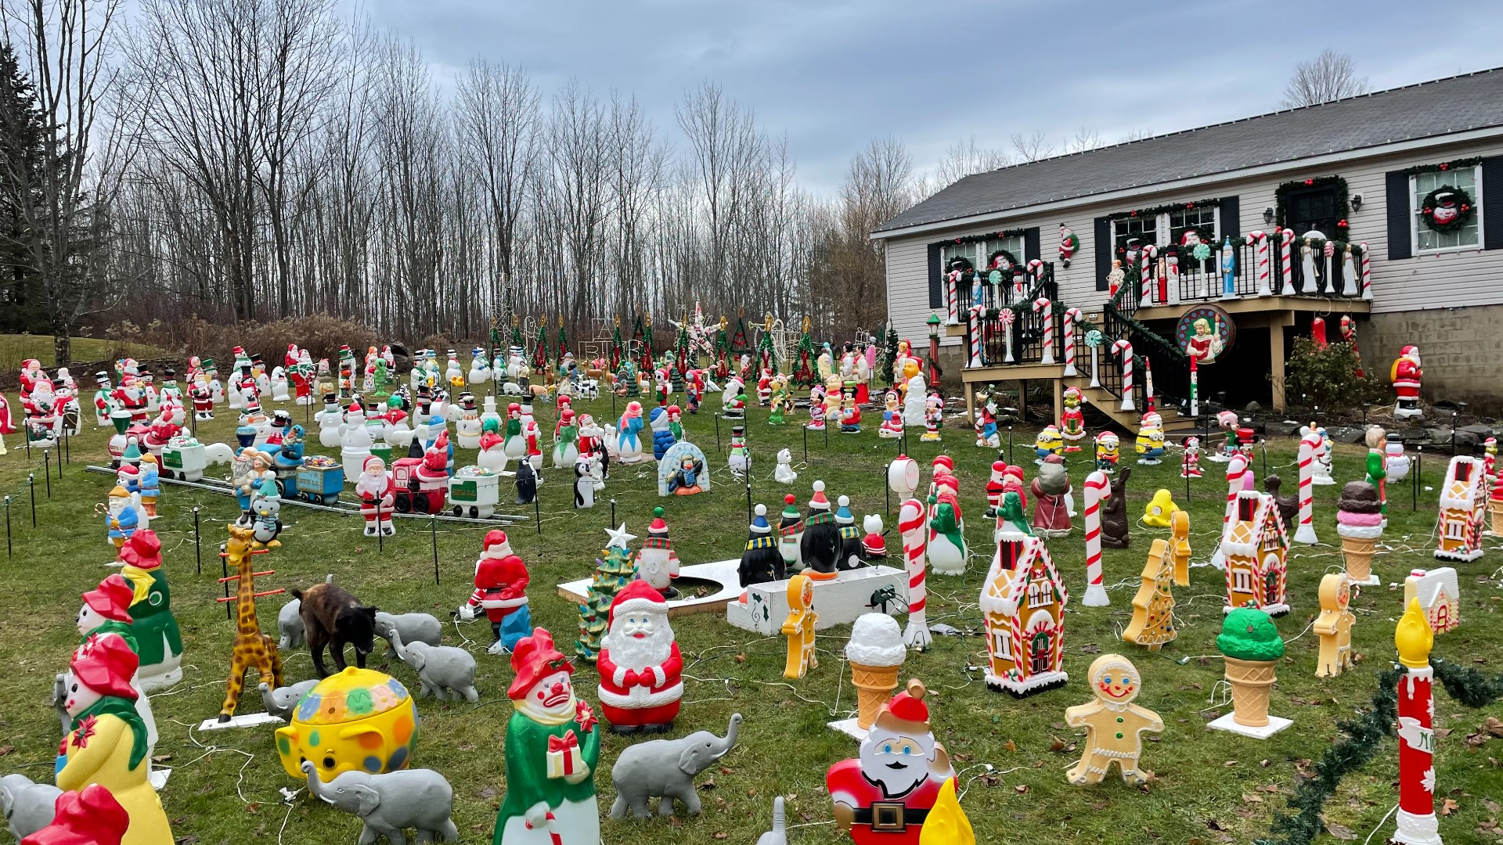

Addiction & YOUR BRAIN:
What is the connection?
How do you know something is important to you?

Slide 57
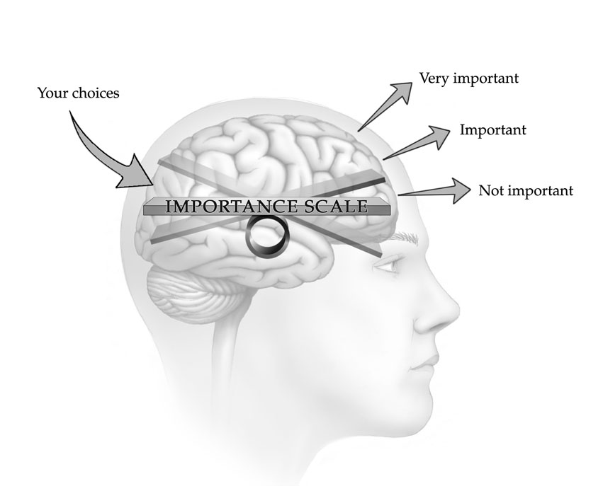
IMPORTANCE
You may THINK many things are important
Your ACTIONS will show what is currently important
How you spend your TIME, ENERGY and RESOURCES indicates importance

Slide 58

THE FIRST TIME…

Slide 59
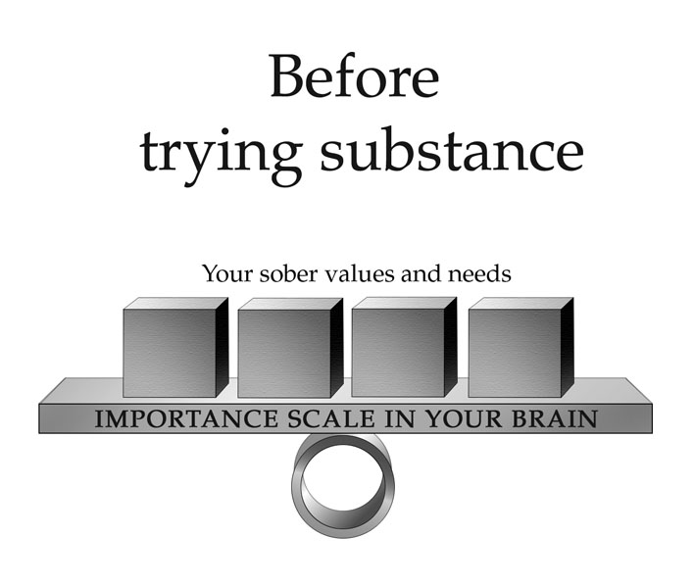
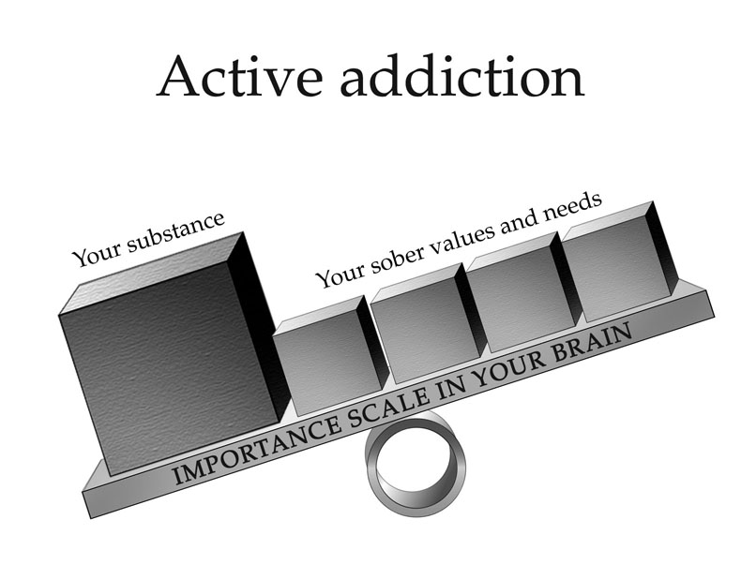
ENTER ADDICTION
DRUGS BECOME MORE IMORTANT THAN PERSONAL VALUES AND NEEDS

Slide 60
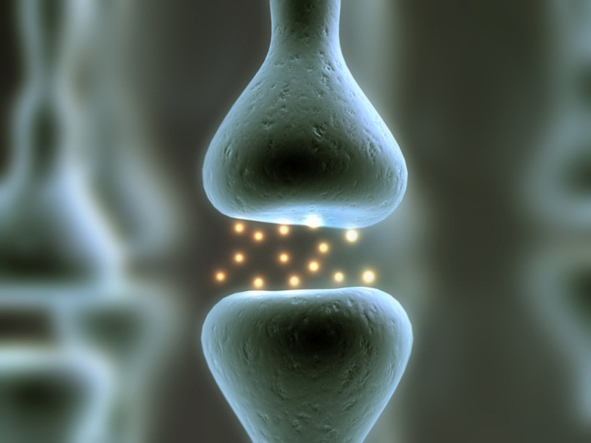
HOW DOES YOUR BRAIN CHANGE?
Nerve Cells Release Chemicals (Dopamine) when there is a new experience
Brain creates memories of the experience
Increases motivation to repeat the experience

Slide 61
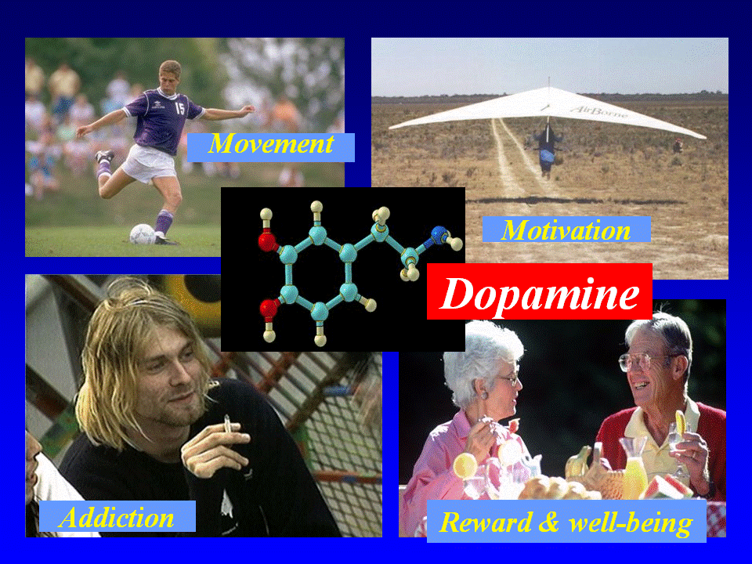

Slide 62

MORE DOPAMINE RELEASED
…. The more importance is
placed on the experience

Slide 63
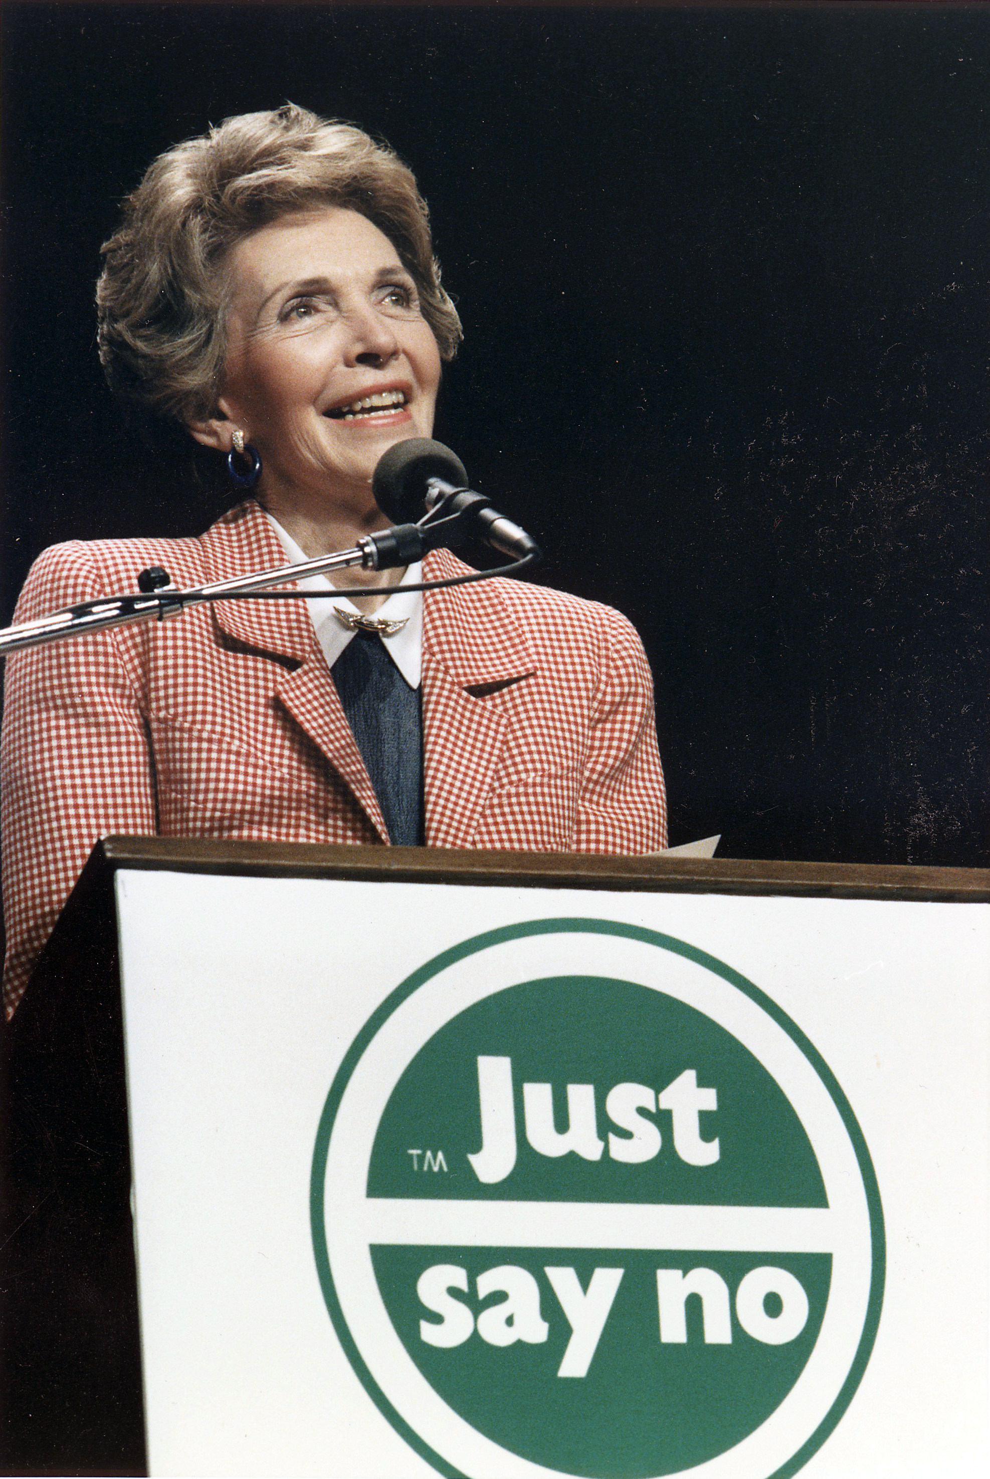

Not a fair fight

Slide 64
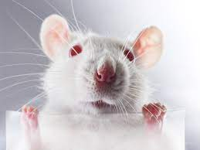
Food vs Drugs
Dopamine
Cocaine snorting
Crack cocaine smoking
Food
Meth IV

Slide 65

IMPORTANCE SCALE

Slide 66
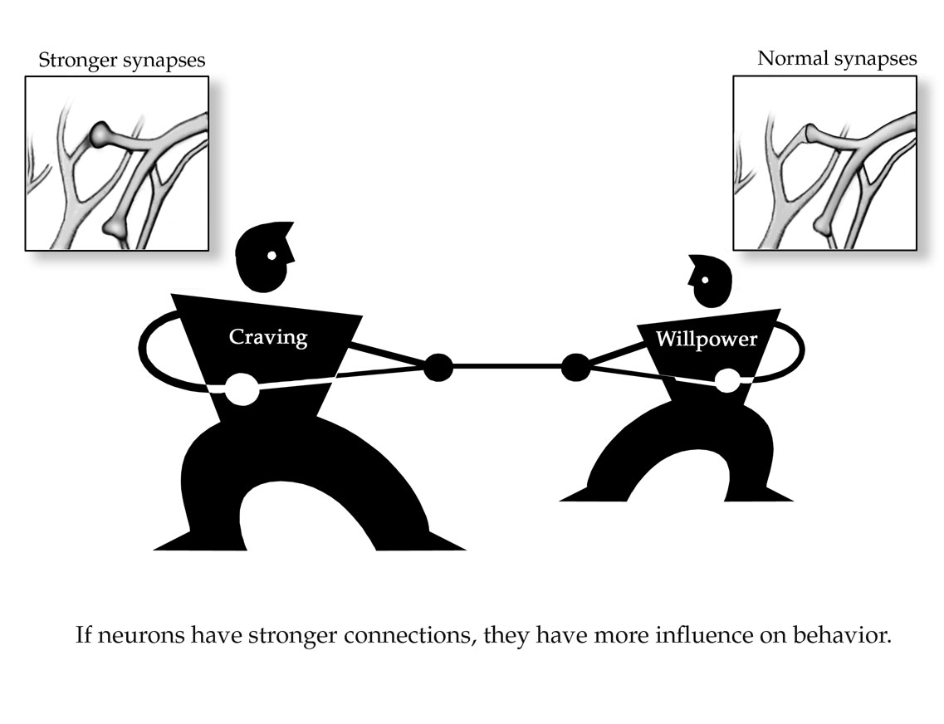

Slide 67
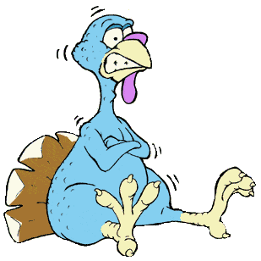
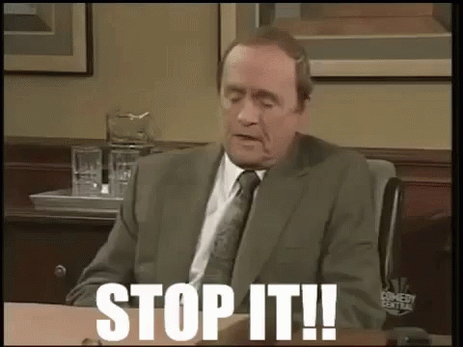
“JUST QUIT COLD TURKEY”

Slide 68
Addiction is a chronic, relapsing Disease, which causes long-lasting physical and chemical changes in areas of your brain that control:
  Responses to reward and stress
  Personal priorities
  Decision making
  Behavior
As a result you:
  Feel far less pleasure from normal rewards
  Are more susceptible to stress
  Experience negative emotions with greater intensity
  Are preoccupied with the substance
  Engage in compulsive substance use despite its harmful consequences

Slide 69
Can you just quit?
Would quitting cure your addiction?

Slide 70

Abstinence
90% release rate without treatment after 1 year

Slide 71

Top 3 Relapse Triggers
First Drink/Use
Increased Psychosocial Stressors
Cues / Reminders

Slide 72
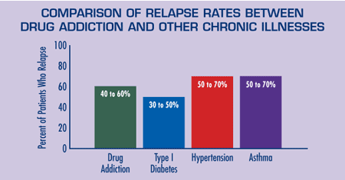
Thinking of Addiction as a chronic illness

Slide 73

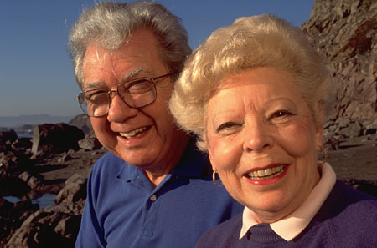

Finding Hope in recovery
Addiction, like any other chronic disease, can be managed successfully
Treatment may help you to
  Stop using
  Live fulfilling lives
The longer you remain abstinent your chances to remain abstinent increase

Slide 74
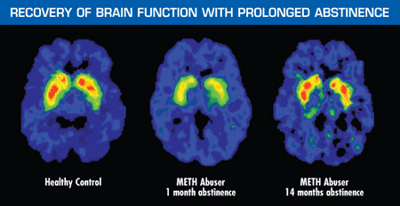
Addiction need not be a life sentence

Slide 75
What can be done to help the brain recover?

Slide 76
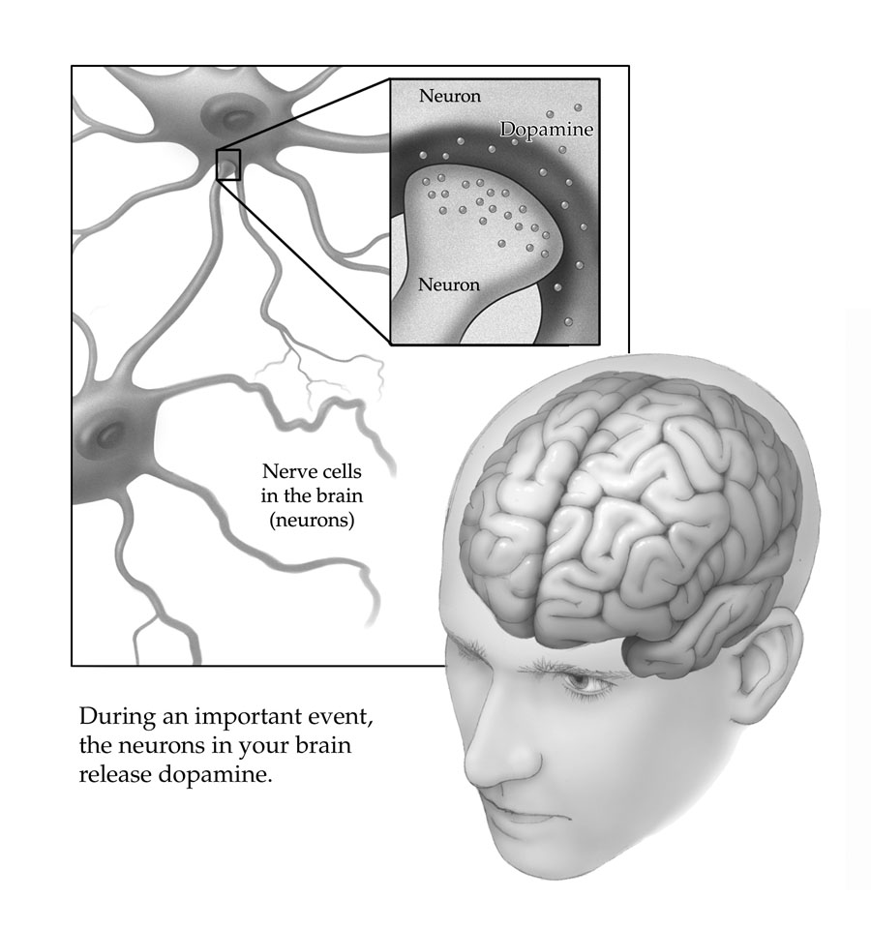
RECOVERY Action Plan
RECOVERY ACTIONS
  Strengthen your brain connections in areas that manage emotions, motivation, determination of choices and ultimate control
  With time and practice, healthy choices become easier, and the quality of your life in recovery improves

Slide 77

You Recovery Actions: “Building Blocks” of Recovery
Physical
Maintain abstinence
Practice wellness
Get your health problems treated
Take your medications
Psychological and Spiritual
Develop a healthy self-esteem
Keep future oriented perspective
Live up to your personal values
Take care of your personal needs
Manage your emotions and stress
Social
Build up a secure base
Build up a sober support system
Develop healthy relationships
Establish intimacy when ready

Slide 78
RECOVERY BUILDING BLOCKS?
Treatment and Therapy
Support System
Education
Lifestyle Changes
Mindfulness and Stress Management
Relapse Prevention Strategies
Spirituality or Meaningful Connections
Personal Accountability
Continuous Growth and Learning
Post-Treatment Planning

Slide 79
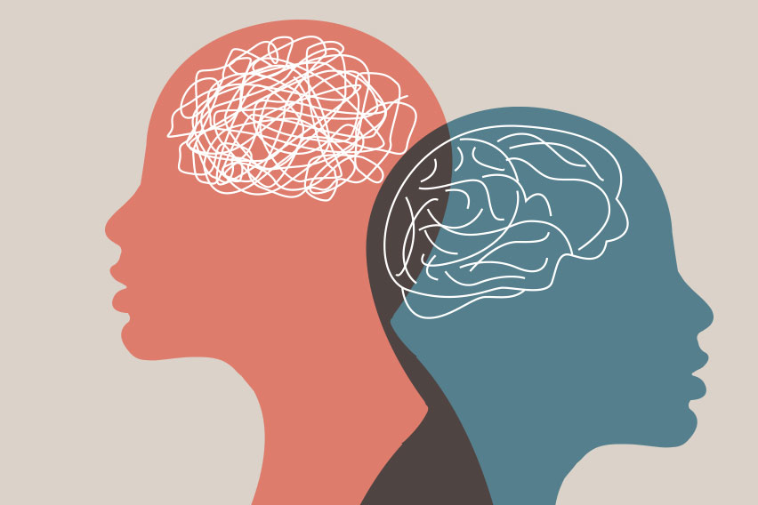
Co-occurring / Dual Diagnosis
Mental Health Disorder + Substance Use Disorder
Overlap with impact on well-being, functioning and quality of life
May involve >1 SUD & >1 MHD

Slide 80
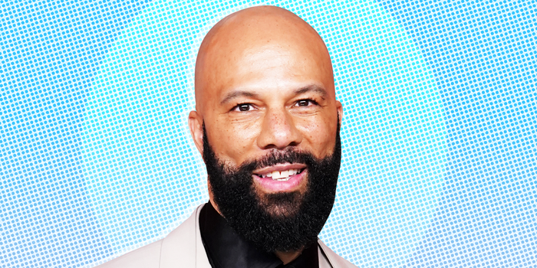
Prevalence
“Throughout these recent years I have definitely used therapy as part of my healing and mindfulness and taking care of my mental, emotional and spiritual health”

Slide 81
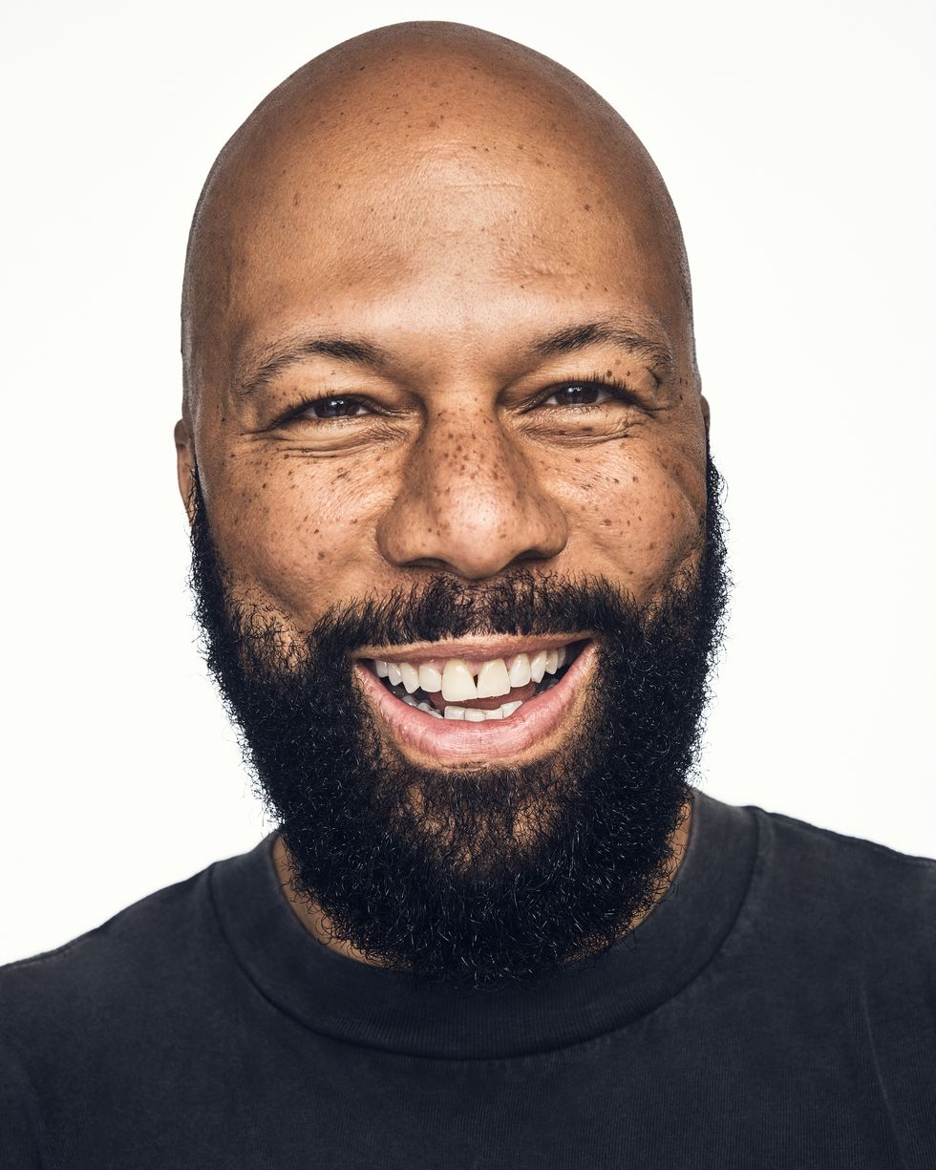
PREVALENCE
Common
2020: 9.5 million adults had co-occurring mental health and substance use disorders
Depression & Alcohol Use Disorder (1 in 4)
50% experience substance use disorder if dx of Schizophrenia/Bipolar
Known Consequences

Slide 82
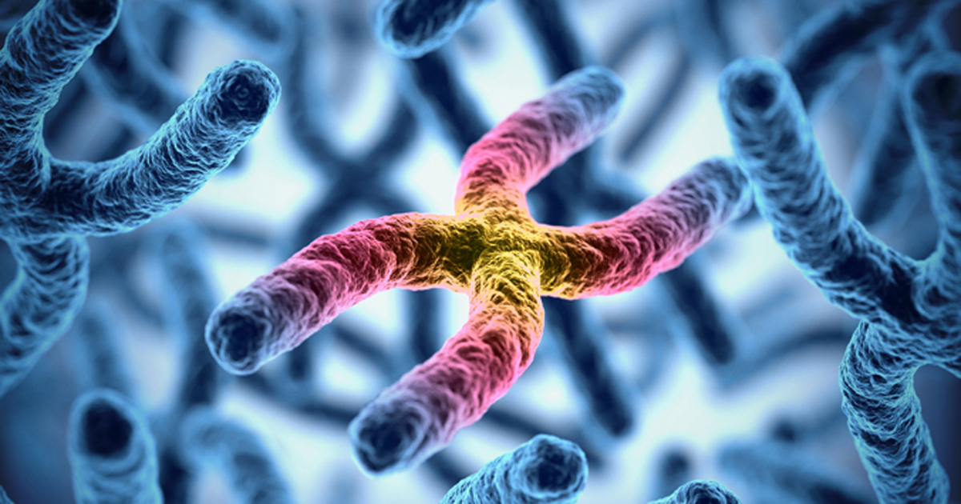
Why so common?: Contributing factors
Genetic Factors

Slide 83

Why so common?: Contributing factors
Genetic Factors
Biological Factors

Slide 84

Why so common?: Contributing factors
Genetic Factors
Biological Factors
Social and Environmental Factors

Slide 85
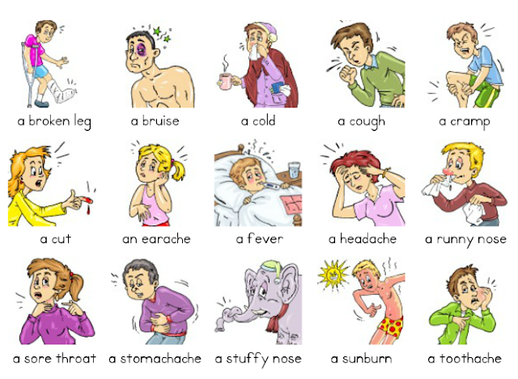
Why so common?: Contributing factors
Genetic Factors
Biological Factors
Social and Environmental Factors
Medical Problems

Slide 86
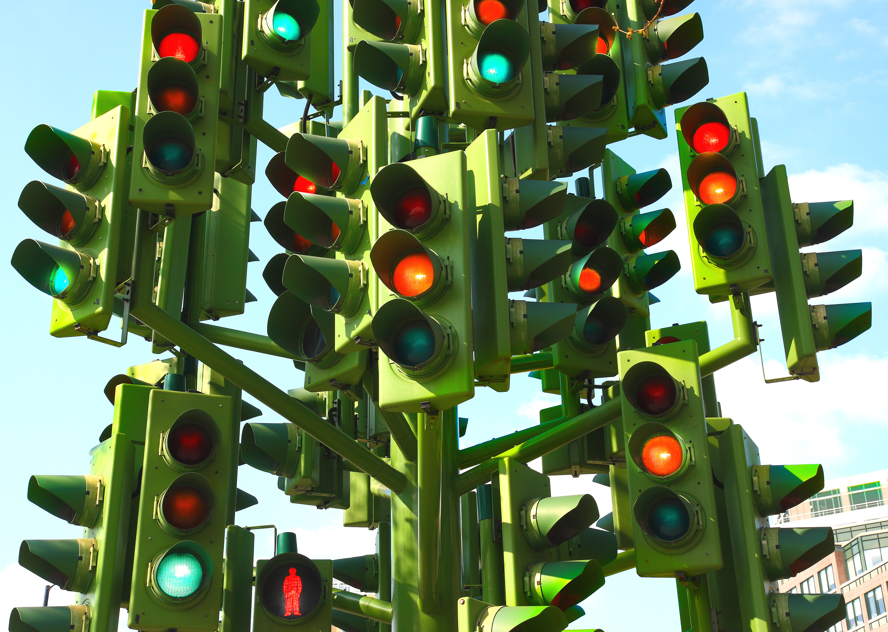
Diagnostic dilemma
Primary Psychiatric Disorder w/ Secondary Substance Use Disorder
Primary Substance Use Disorder with Secondary Psychiatric Disorder
Dual Primary

Slide 87
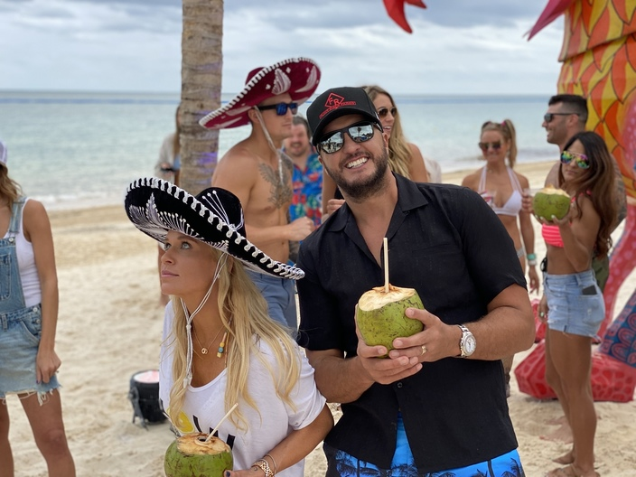
Effects of mental illness on addiction
Self-Medicating → Increased Vulnerability
Increased Severity of Addiction
Treatment of Addiction Interference → Relapse

Slide 88
Effects of addiction on mental illness
Cover, Worsen, Contribute
Increased Difficulty Diagnosing MI
Worsen Symptom Severity of MI
Increased Suicide Risk
Interference with Psychotropic Medications

Slide 89

Treatment

Slide 90

Treatment
General Approach
  Acute Intervention

Slide 91
Safety issues
Identify Risk and Plan to prevent suicide or self-harm
Risk factors
  Prior suicide attempt or pattern of self-destructive behavior
  Suicide plan
  Acute episode of psychiatric illness
  Feels of helplessness / hopelessness
  Recent loss (within last 6 weeks)
  Active alcohol/illicit drug use

Slide 92
Patient role in treatment
Acknowledge
Seek information and resources
Follow-up with care team
Develop a plan
Seek support from self-help recovery programs
Focus on yourself
Realistic expectations

Slide 93
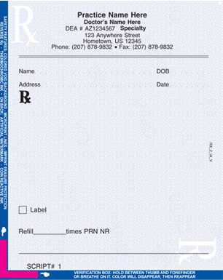
Pharmacologic interventions
  Alcohol use disorder
  Opioid use disorder
  Stimulant use disorder
  Cannabis use disorder

Slide 94

Alcohol Use Disorder
FDA-Approved Medications
  1. disulfiram (Antabuse)
  2. acamprosate (Campral)
  3. naltrexone (Revia, Vivitrol)

Slide 95
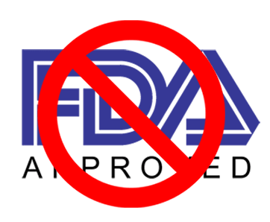
Alcohol Use Disorder
Off-Label Medications
  1. topiramate (Topamax)
  2. baclofen
  3. gabapentin

Slide 96
OPIOID Use Disorder
FDA-Approved Medications
  1. methadone
  2. buprenorphine (suboxone, sublocade)
  3. naltrexone (Vivitrol)

Slide 97
OPIOID Use Disorder
Off-Label Medications
  1. clonidine
  2. mirtazapine (Remeron)
  3. modafinil

Slide 98
stimulant Use Disorder
FDA-Approved Medications
  No FDA-approved medications for StUD

Slide 99
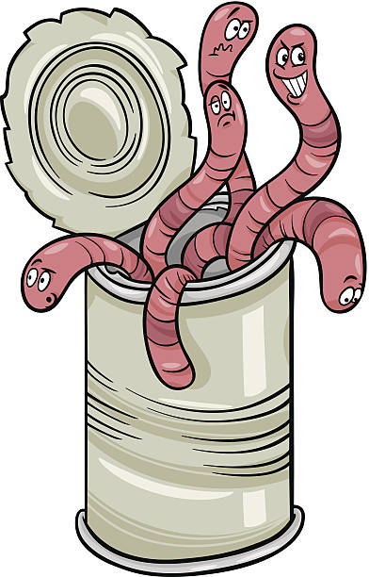
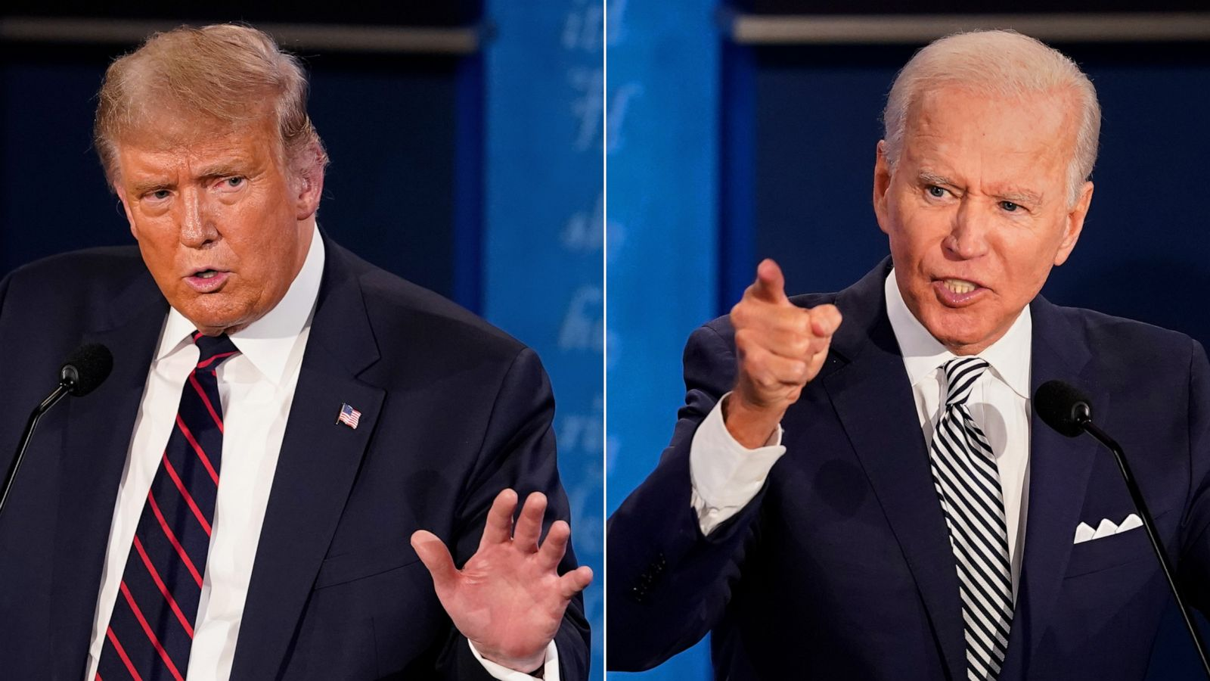
stimulant Use Disorder
Off-Label Medications
  1. N-acetylcysteine (NAC)
  2. bupropion (Wellbutrin) +/- naltrexone *new recommendation as of 11/2023
  3. mirtazapine
  4. ?stimulants?

Slide 100
marijuana Use Disorder
FDA-Approved Medications
  No FDA-approved medications for marijuana use disorder

Slide 101
Marijuana Use Disorder
Off-Label Medications
  1. acamprosate (Campral)
  2. naltrexone
  3. quetiapine (Seroquel)

Slide 102
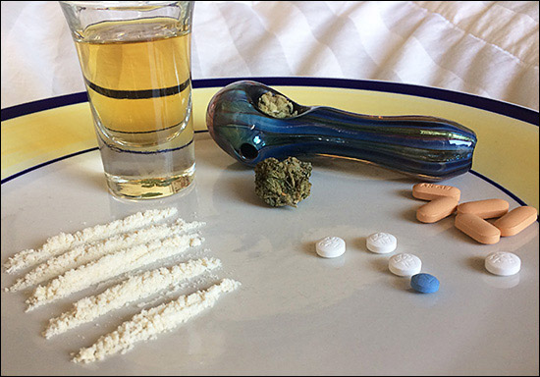
POLYSUBSTANCE PANDEMIC

Slide 103
Treatment and Recovery
Evidence-based treatment approaches beyond medications only
Access to treatment program services
Recovery and rehabilitation
Individualization

Slide 104
Stigma and Barriers
Address the stigma associated with SUD: Impact on seeking help
Barriers to accessing treatment, including social and structural factors

Slide 105
OUT WITH ABSTINENCE
IN WITH Harm Reduction
Pragmatic
Compassionate
Patient Centered
Enhance Safety
Non-Judgmental

Slide 106
Questions?
Have you noticed harm reduction models being embraced?

Slide 107

Navigating the system

Slide 108
OUTPATIENT SERVICES
  Individual and group counseling
  Medication management
  Intensive outpatient programs (IOPs)

Slide 109
Inpatient SERVICES
  Individual and group counseling
  Medication management
  Detoxification
  24/7 Medical Supervision
  Safety

Slide 110
Residential treatment
Structured living environments
Comprehensive therapy and support
Longer-term residential care - duration of stay typically ranges from weeks to months
Some focus on addressing co-occurring disorders

Slide 111
Partial hospitalization programs (php)
Structured daytime treatment
Daily therapy and medical support
Patients return home in the evenings

Slide 112
Continuing care and aftercare
Transitioning from intensive treatment to ongoing support
12-step programs, support groups and therapy

Slide 113

Telehealth / Telemedicine / Virtual Care

Slide 114

Telehealth / Telemedicine / Virtual Care
  Data is supportive, especially for group therapy and treatment of substance use disorders

Slide 115
Questions?
How have you seen telehealth impact patients?

Slide 116
The Future

Slide 117

Next wave - Psychedelics

Slide 118
The future
Access
Simplification
New modalities
Bring interventional procedures to rural areas.
TMS within 30 minutes of home.
Home device use.
Faster protocols.
Higher efficacy.
Reduce insurance barriers.
Treat more mental health conditions.
Epigenetics.
Viral vector-based brain changes.

Slide 119
society
cleaner
Technology
Peace
LEAN IN/OUT
Manage pollution.
Figure out how to use technology and social media with constraints.
Community and togetherness.
Find a balance between support and acceptance of mental health.

Slide 120
Questions?
Where do you see the future of mental health going?

Slide 121
SUMMARY
Interventional psychiatry is an exciting development in an old, slow-moving specialty. Access and funding are major limitations to utilizing these treatments. More FDA approvals are likely in the next couple of years. Psychedelics will revolutionize care for some. Overall, the next 5-20 years look bright in mental health treatment expansion.

Slide 122
references
Daly E, Trivedi M, Janik A, et al. Esketamine nasal spray combined with an oral antidepressant for relapse prevention in treatment-resistant depression: results of a double-blind, randomized withdrawal, multicenter study (SUSTAIN-1). Poster presented at: European College of Neuropsychopharmacology (ECNP) Congress; October 7, 2018; Barcelona, Spain.
Darrow, David. Vagal Nerve Stimulation for Treatment-Resistant Depression. Presentation. 7/11/2023.
Denison T, Morrell MJ. Neuromodulation in 2035: The Neurology Future Forecasting Series. Neurology. 2022; 98(2):65–72.
Fedgchin M, Trivedi M, Daly E, et al. Randomized, double-blind study of fixed-dosed intranasal Esketamine plus oral antidepressant vs. active control in treatment-resistant depression. Poster presented at: 9th Biennial Conference of the Internatinal Society for Affective Disorders (ISAD); September 20-22, 2018; Houston, Texas.
Francois, Dimitry, and Elaina Della. "10 Myths about ECT." Current Psychiatry 17, no. 7 (July 2018). Accessed May 22, 2019. https://www.mdedge.com/psychiatry/article/168851/depression/10-myths-about-ect.
Grover, Sandeep, Swapnajeet Sahoo, Anjumoni Rabha, and Raman Koirala. "ECT in Schizophrenia: A Review of the Evidence." Acta Neuropsychiatrica, 2018, 1-13. doi:10.1017/neu.2018.32.
Hermann, Richard C., Susan L. Ettner, Robert A. Dorwart, Claudia W. Hoover, and Elaine Yeung. "Characteristics of Psychiatrists Who Perform ECT." American Journal of Psychiatry 155, no. 7 (1998): 889-94. doi:10.1176/ajp.155.7.889.
Janssen Research & Development LLC. A randomized, double-blind, multicenter, active-controlled study of intranasal Esketamine plus an oral antidepressant for relapse prevention in treatment-resistant depression. In: ClinicalTrials.gov [Internet]. Bethesda (MD): National Library of Medicine (US). 2000- [1/24/2018]. NCT02493868. https://clinicaltrials.gov/ct2/show/NCT02493868.
Ochs-Ross R, Daly EJ, Lane R, et al. Efficacy and safety of Esketamine nasal spray plus an oral antidepressant in elderly patients with treatment-resistant depression. Poster presented at: Annual Meeting of the American Society of Clinical Psychopharmacology (ASCP); May 29-June 1, 2018; Miami, Florida.
Popova, V, Daly EJ, Trivedi M, et al. "Efficacy and Safety of Flexibly Dosed Esketamine Nasal Spray Combined With a Newly Initiated Oral Antidepressant in Treatment-Resistant Depression: A Randomized Double-Blind Active-Controlled Study." American Journal of Psychiatry, 2019. doi:10.1176/appi.ajp.2019.19020172.
Popova V, Daly EJ, Trivedi M, et al. Randomized, double-blind study of flexibly-dosed intranasal Esketamine plus oral antidepressant vs active control in treatment-resistant depression. Poster presented at: Annual Meeting of the American Society of Clinical Psychopharmacology (ASCP); May 29 - June 1, 2018; Miami, Florida.
Rasmussen, Keith G. Principles and Practice of Electroconvulsive Therapy. Washington, DC: American Psychiatric Association Publishing, 2019.
Ross, Eric L., Kara Zivin, and Daniel F. Maixner. "Cost-effectiveness of Electroconvulsive Therapy vs Pharmacotherapy/Psychotherapy for Treatment-Resistant Depression in the United States." JAMA Psychiatry 75, no. 7 (2018): 713. doi:10.1001/jamapsychiatry.2018.0768.
Rush, A. J., Trivedi, M. H., Wisniewski, S. R., et al. Acute and longer-term outcomes in depressed outpatients requiring one or several treatment steps: a STAR*D report. The American journal of psychiatry, 163(11), 1905–1917.
Saddock, Bejamin. Kaplan and Saddock’s Comprehensive Textbook of Psychiatry. 9th edition.
SPRAVATO (Esketamine nasal spray) [Prescribing Information]. Titusville, NJ: Janssen Pharmaceuticals, Inc; https://imedicalknowledge.veevavault.com/ui/approved_viewer?token=7994-21c864d4-b928-49c5-b101-4d34e95f2be3.
Wajs E, Aluisio L, Morrison R, et al. Long-term safety of Esketamine nasal spray plus oral antidepressant in patients with treatment-resistant depression: SUSTAIN-2 phase 3 study. Poster presented at: European College of Neuropsychopharmacology (ECNP) Congress; October 6-9, 2018; Barcelona, Spain.

Slide 123
Contact us
Dr. Dan Montville
montvillemd@theremedymn.com
Dr. Glen Rebman​
drrebman@theremedymn.com

Slide 124

Phone: 952-431-5330
www.theremedymn.com
MN Locations: Vadnais Heights, Burnsville, Chaska, Maple Grove
WI Locations: Hudson

Slide 125
Keep Your Coverage team
Unique program that helps members retain eligibility for UCare’s MSHO
This Medicaid renewal service helps members avoid gaps in coverage and care
612-676-3438 or 1-855-307-6978
TTY 612-676-6810 or 1-800-688-2534
8 am – 5 pm, Monday – Friday
UCare’s Minnesota Senior Health Options (MSHO) (HMO D-SNP)

Slide 126
Keep Your Coverage specialists can:
Identify members at risk of losing eligibility
Contact members to remind them to complete their Medicaid renewal forms and Account Validation Services (AVS) release form
Help with completing forms when needed
Work with county financial workers and case managers
Direct members to correct resources
Educate members about benefits and provider network
UCare’s Minnesota Senior Health Options (MSHO) (HMO D-SNP)

Slide 127



Make referrals to UCare’s SNP Plans
Enroll online
Visit ucare.org to share enrollment materials with applicants and
submit enrollment requests.
Enroll by phone
Prospective members may call a licensed agent to enroll at
1-800-707-1711 (TTY 1-800-688-2534); 8 am – 5 pm, Monday – Friday
Enroll by mail
Send a secure email to UCare’s licensed agents at SNPSales@ucare.org. We’ll phone potential members at their request or mail them an enrollment packet. And share our brochures with business reply cards to make it easy to request enrollment materials by mail.

Slide 128
Thank you for attending!
Please take a moment to provide your feedback: CEU Survey

